Slide 1
Computer Graphics I Tutorial: Hello OpenGL
TA: Yiheng Wu, Zhanrui Zhang, Siyuan Zhang

Slide 2
Outline
CMake
OpenGL, glfw, glad, and glm
How to create a window?
How to draw a triangle?
How to draw a rectangle?
How to draw a colorful rectangle?
How to get time and input?
How to finish HW1?

Slide 3
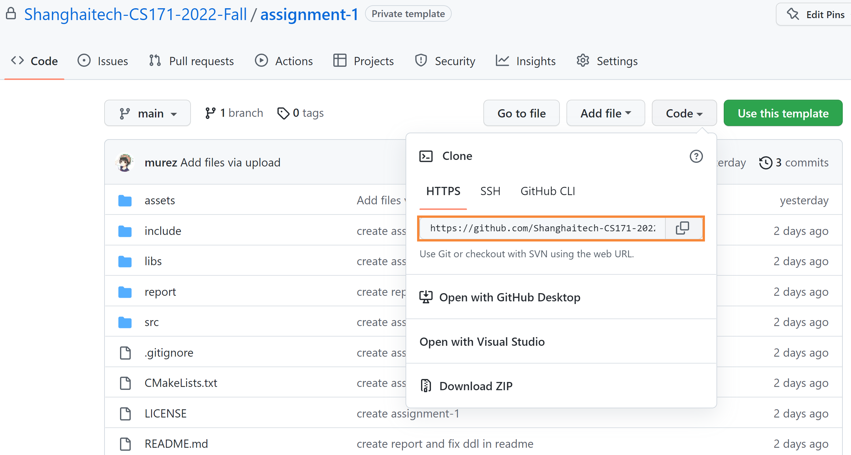
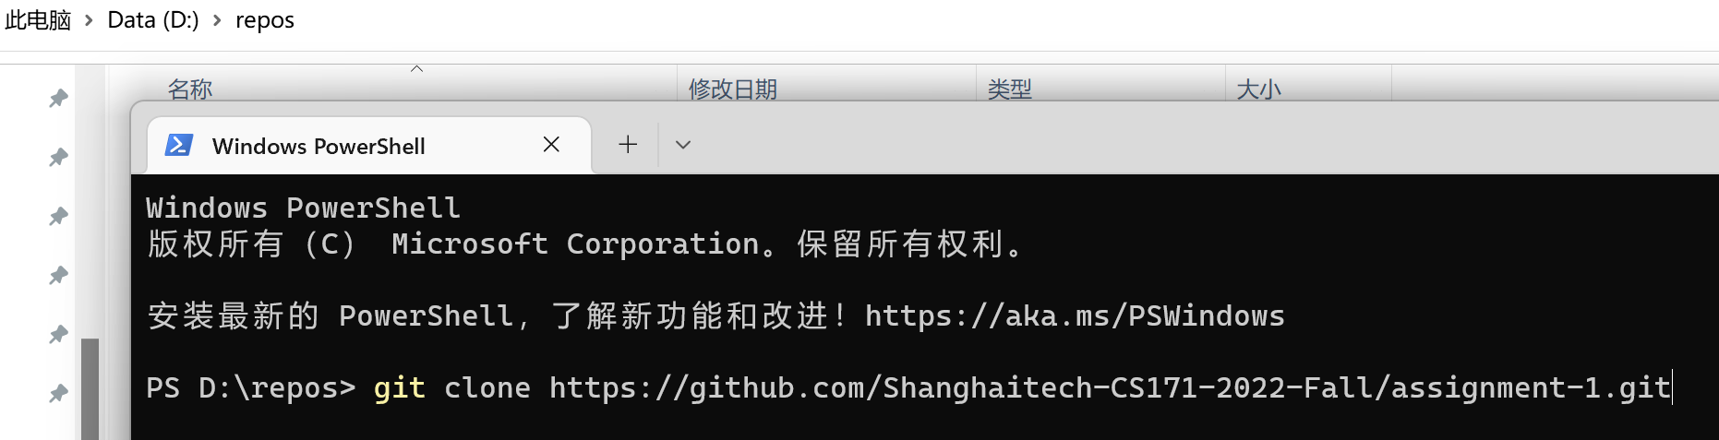
CMake on Windows
Step1: git clone

Slide 4
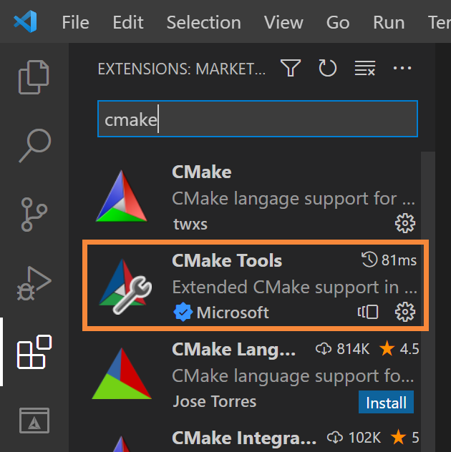
CMake on Windows
Step1: git clone
Step2: vscode
Download this CMake plugin

Slide 5

CMake on Windows
Step1: git clone
Step2: vscode
Download this CMake plugin
Click “File”, “Open Folder”, and select your folder

Slide 6

CMake on Windows
Step1: git clone
Step2: vscode
Download this CMake plugin
Click “File”, “Open Folder”, and select your folder
Click “No Kit Selected”

Slide 7
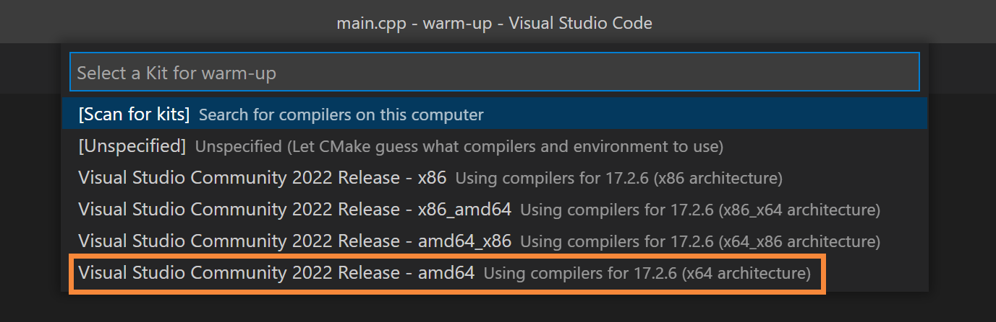
CMake on Windows
Step1: git clone
Step2: vscode
Download this CMake plugin
Click “File”, “Open Folder”, and select your folder
Click “No Kit Selected”
Select “amd64” here

Slide 8
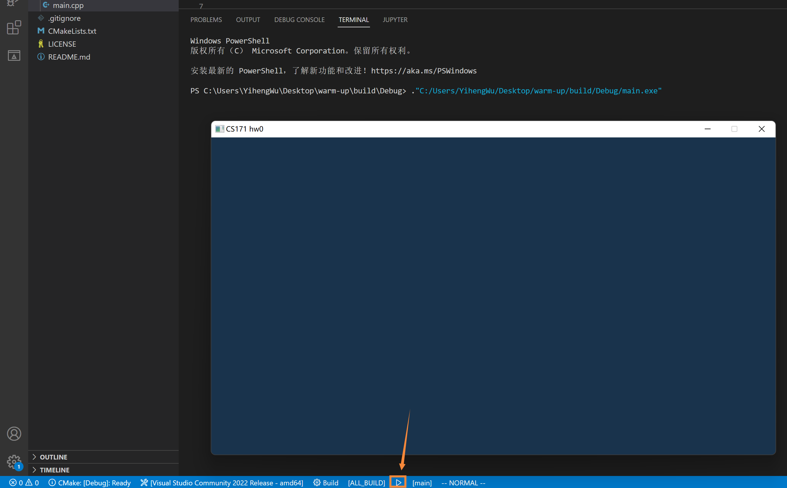
CMake on Windows
Step1: git clone
Step2: vscode
Download this CMake plugin
Click “File”, “Open Folder”, and select your folder
Click “No Kit Selected”
Select “amd64” here
Click the little triangle here

Slide 9
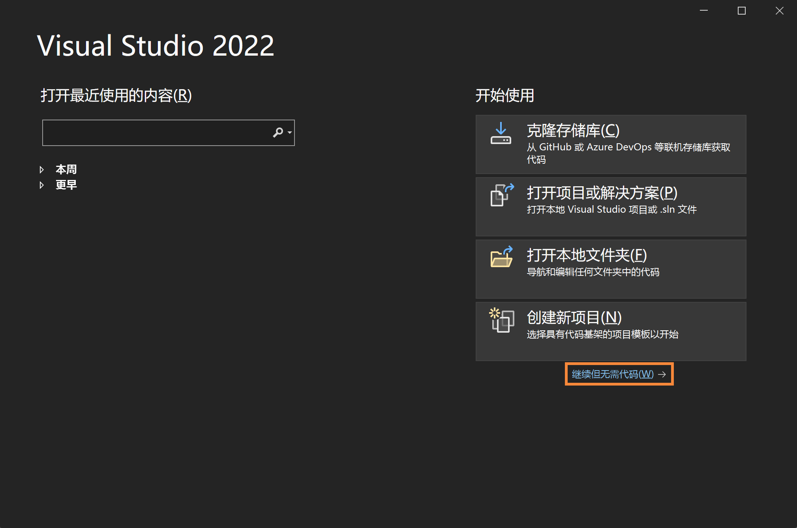
CMake on Windows
Step1: git clone
Step2: vs
Click here

Slide 10
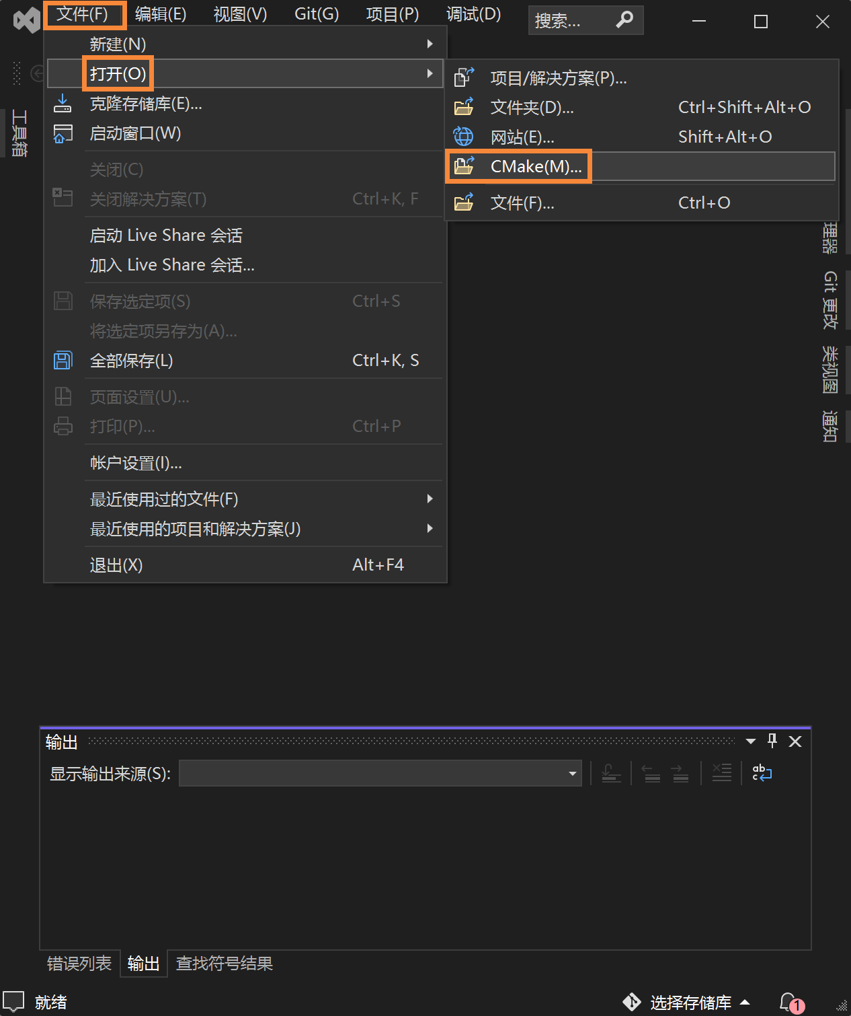
CMake on Windows
Step1: git clone
Step2: vs
Click here
Click “File”, “Open”, “CMake”

Slide 11
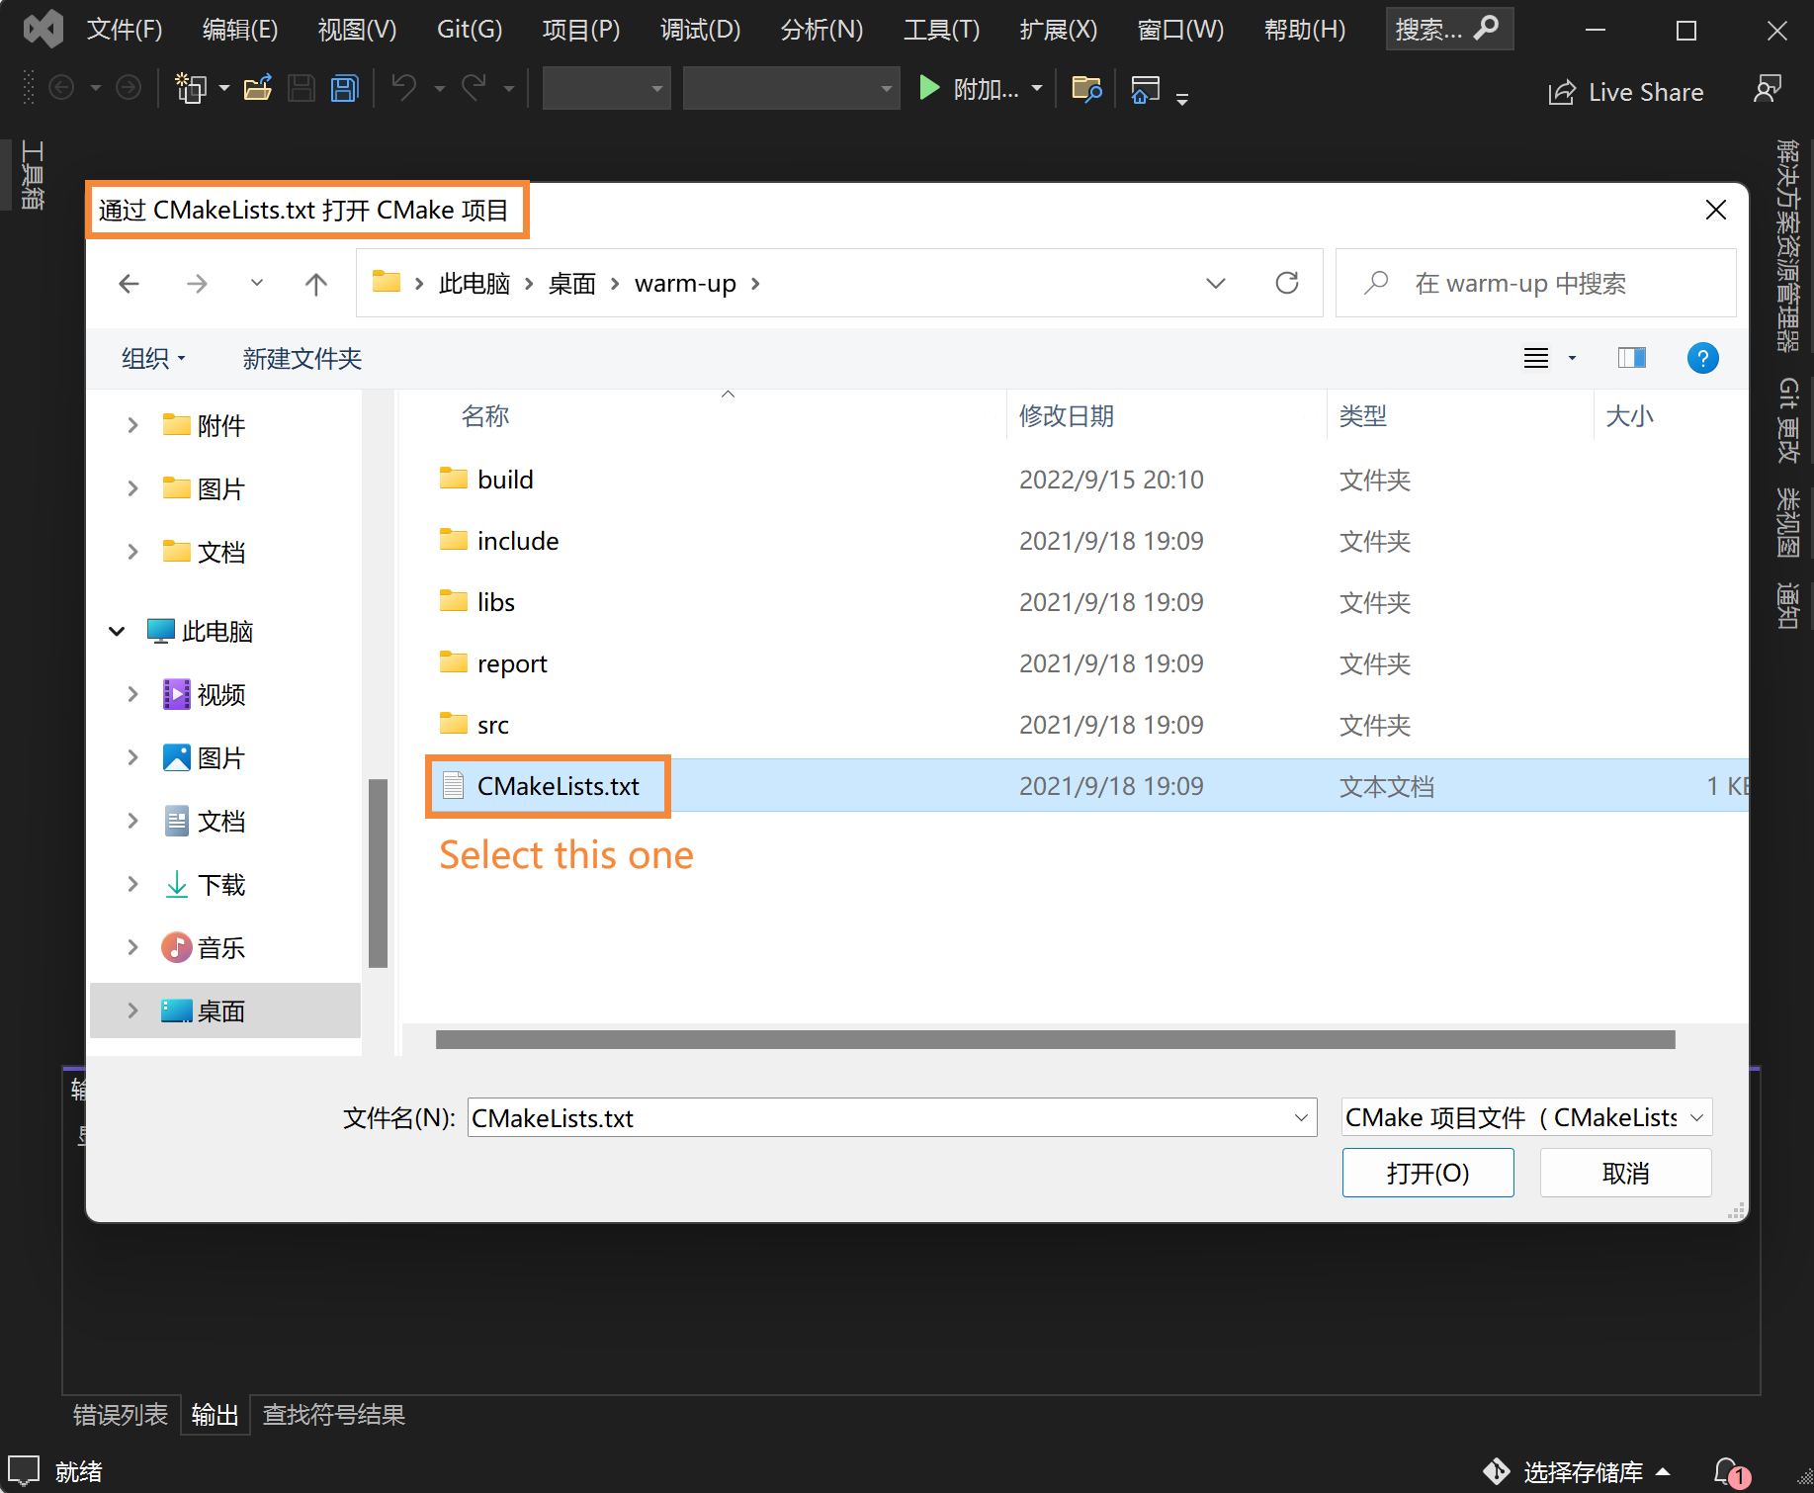
CMake on Windows
Step1: git clone
Step2: vs
Click here
Click “File”, “Open”, “CMake”
Select your “CMakeLists.txt” and open

Slide 12
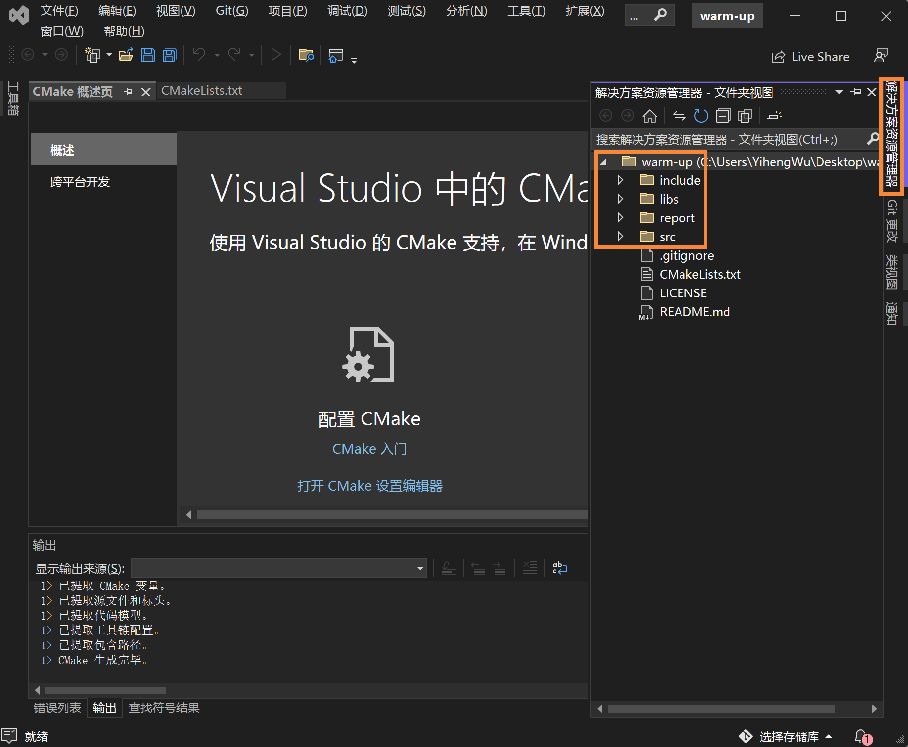
CMake on Windows
Step1: git clone
Step2: vs
Click here
Click “File”, “Open”, “CMake”
Select your “CMakeLists.txt” and open
You can find all the files here

Slide 13
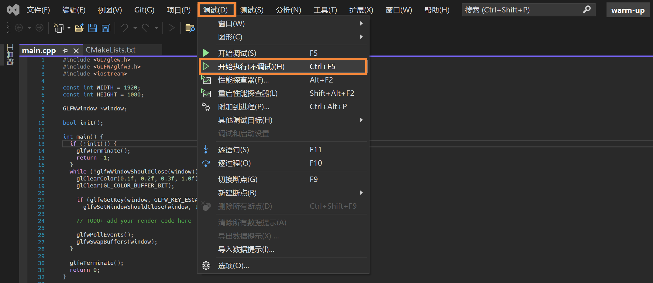
CMake on Windows
Step1: git clone
Step2: vs
Click here
Click “File”, “Open”, “CMake”
Select your “CMakeLists.txt” and open
You can find all the files here
Click here to run

Slide 14
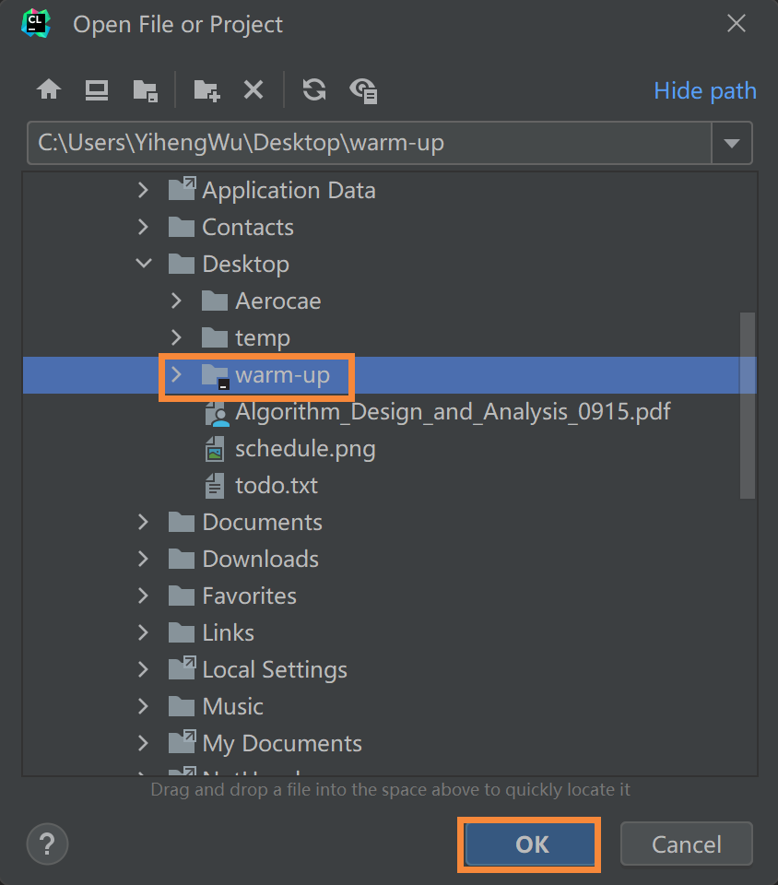
CMake on Windows
Step1: git clone
Step2: clion
Click “Open File or Project”

Slide 15
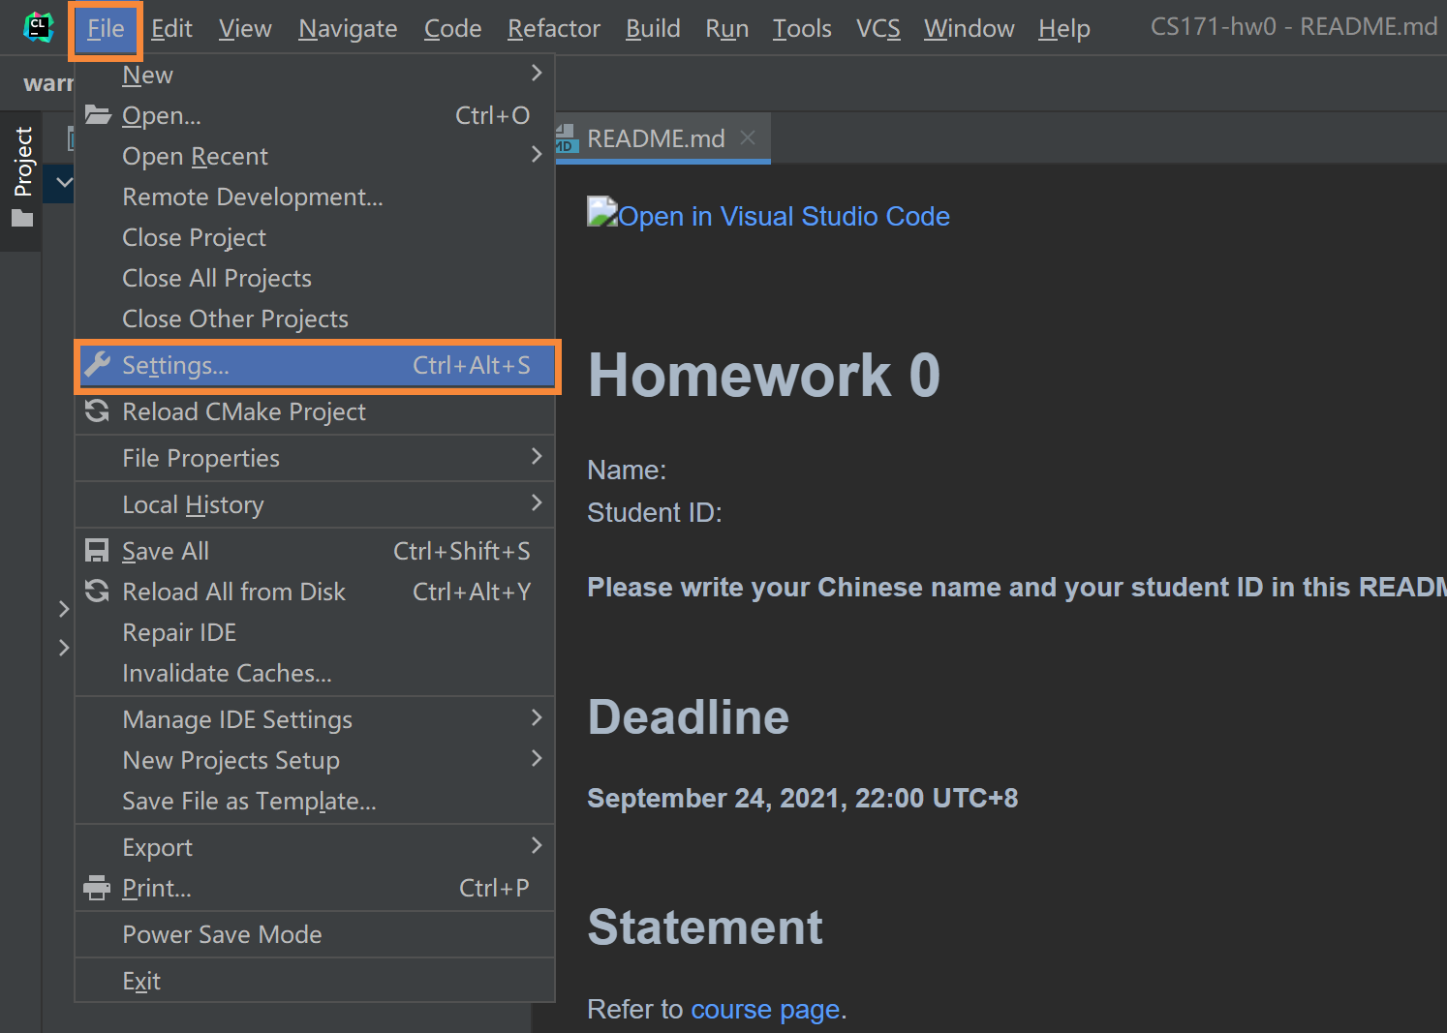
CMake on Windows
Step1: git clone
Step2: clion
Click “Open File or Project”
Click “File”, “Settings”

Slide 16
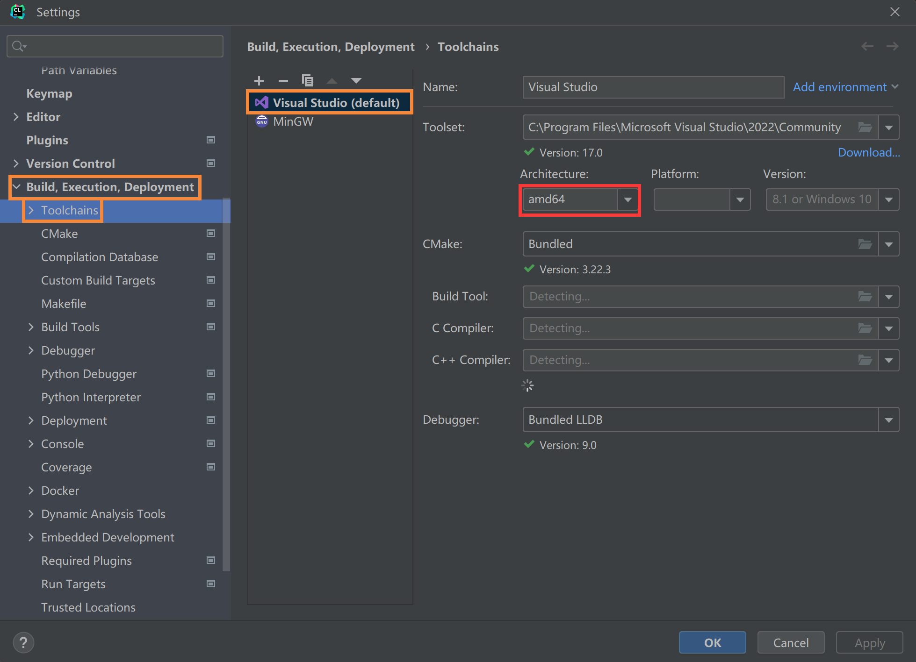
CMake on Windows
Step1: git clone
Step2: clion
Click “Open File or Project”
Click “File”, “Settings”
Set “VS amd64” as the compiler

Slide 17
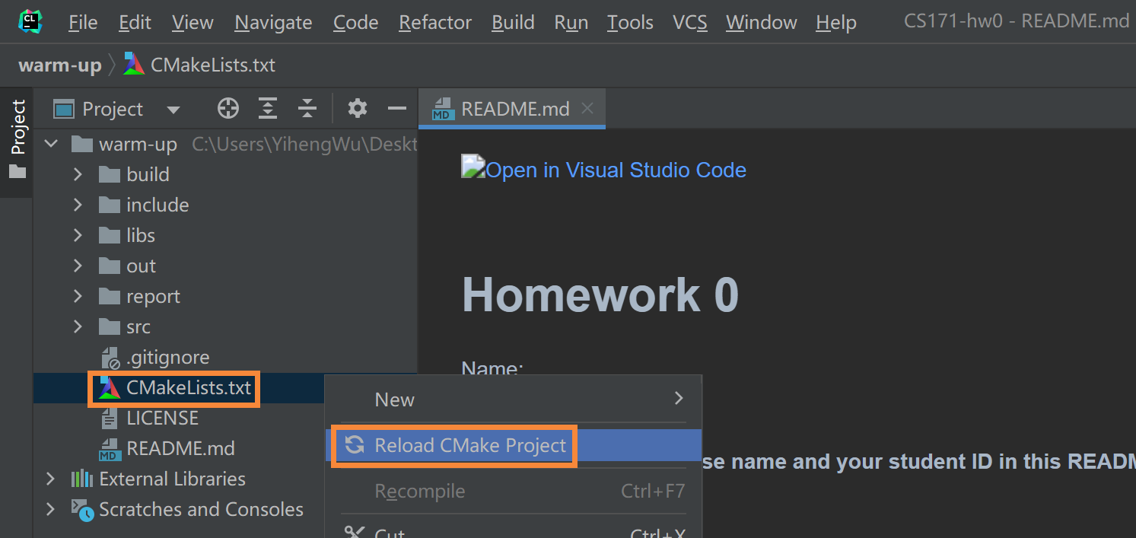
CMake on Windows
Step1: git clone
Step2: clion
Click “Open File or Project”
Click “File”, “Settings”
Set “VS amd64” as the compiler
Reload CMake project

Slide 18
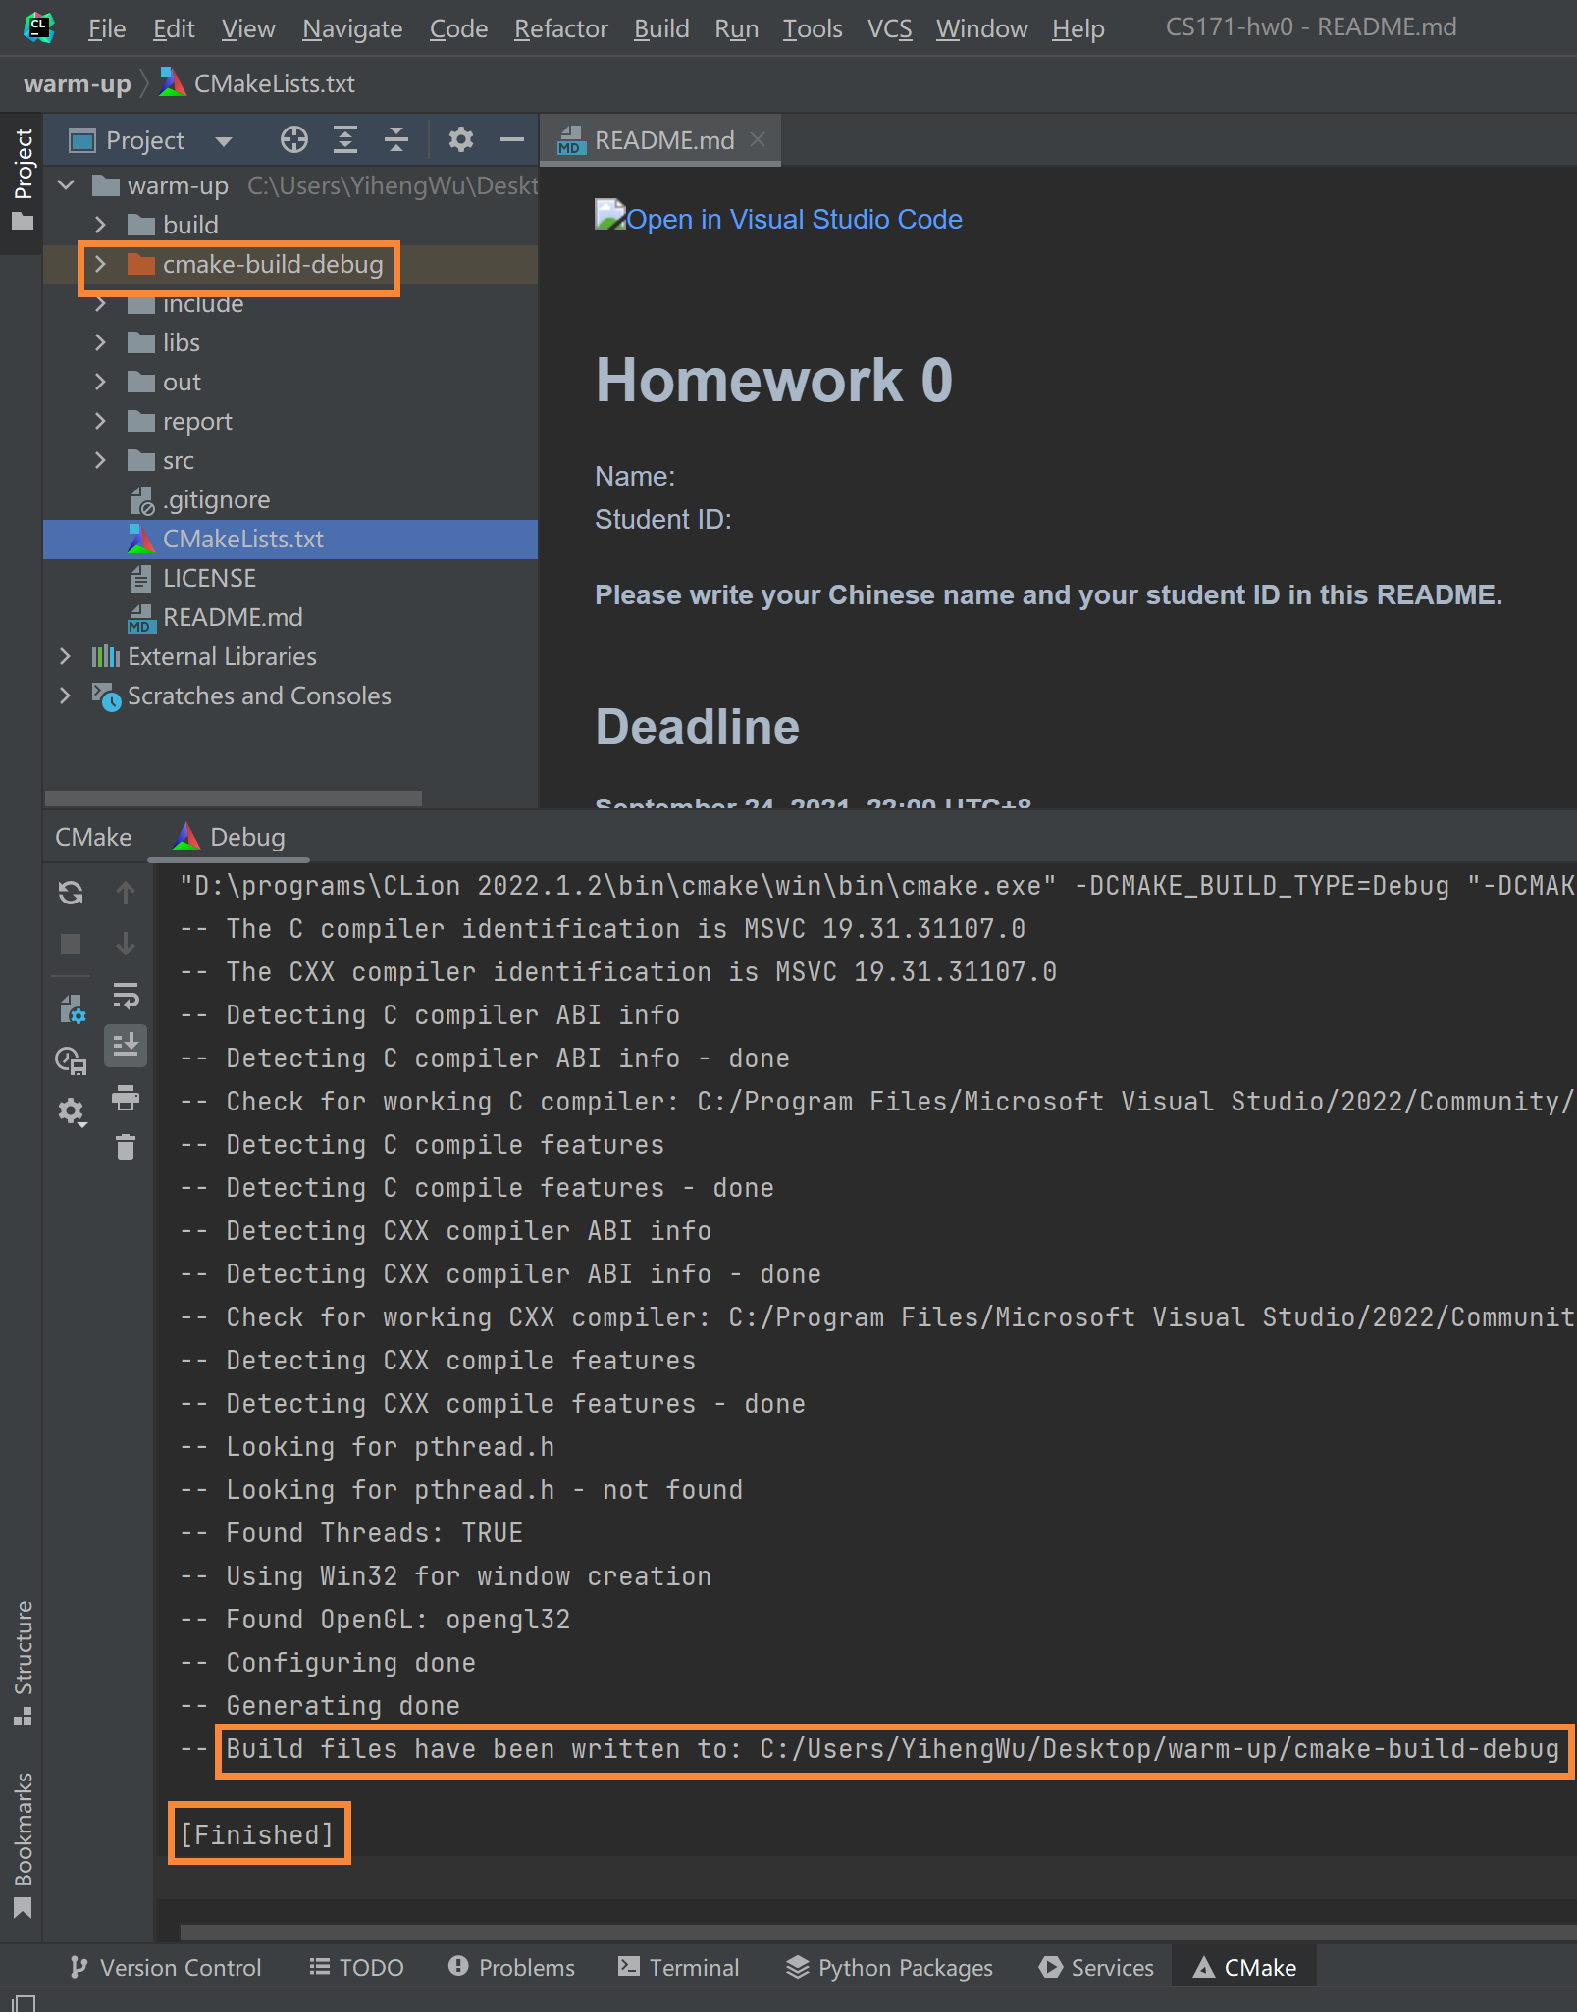
CMake on Windows
Step1: git clone
Step2: clion
Click “Open File or Project”
Click “File”, “Settings”
Set “VS amd64” as the compiler
Reload CMake project
Check success

Slide 19
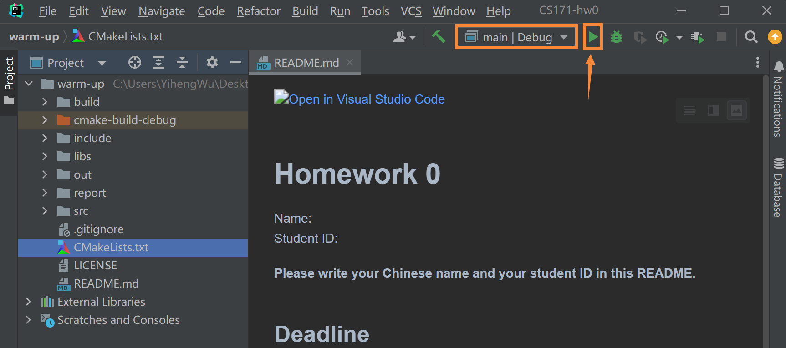
CMake on Windows
Step1: git clone
Step2: clion
Click “Open File or Project”
Click “File”, “Settings”
Set “VS amd64” as the compiler
Reload CMake project
Check success
Click and run

Slide 20
CMake on Linux
Step1: git clone
Step2: g++
mkdir build
cd build
cmake ..
make –j12
Set to “-j12” if your CPU has 12 threads

Slide 21
CMake on Linux
Step1: git clone
Step2: g++
mkdir build
cd build
cmake ..
make –j12
Set to “-j12” if your CPU has 12 threads
./hw0

Slide 22
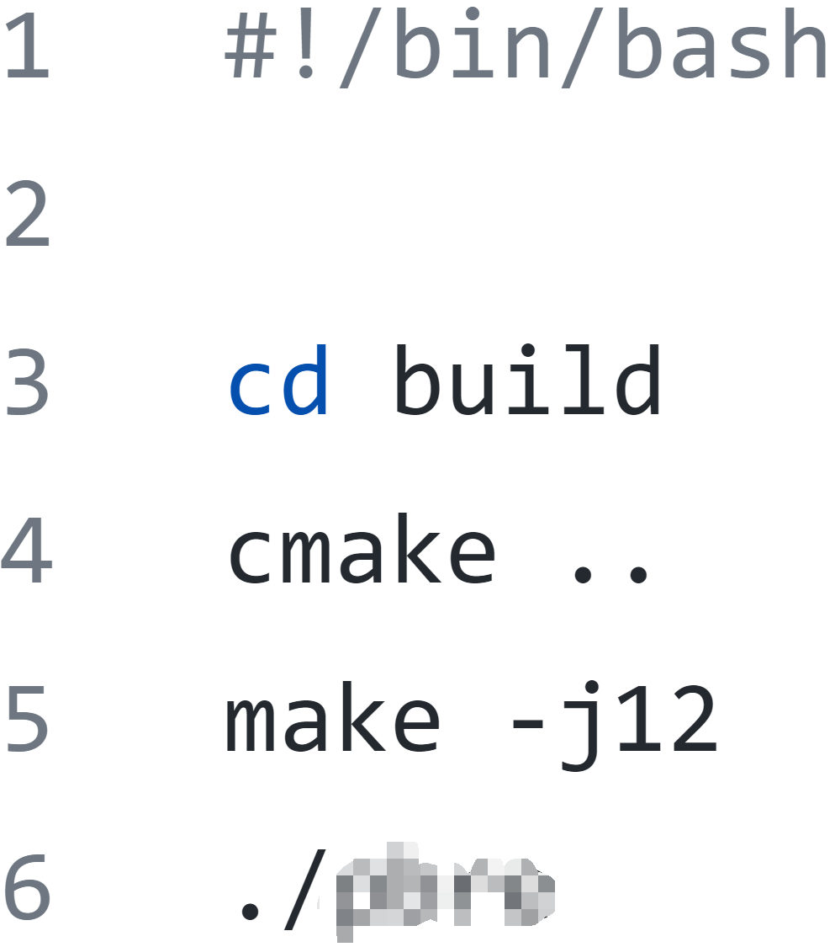
CMake on Linux
Step1: git clone
Step2: g++
mkdir build
cd build
cmake ..
make –j12
Set to “-j12” if your CPU has 12 threads
./hw0
Step3: write a script to automatize

Slide 23
Outline
CMake
OpenGL, glfw, glad, and glm
How to create a window?
How to draw a triangle?
How to draw a rectangle?
How to draw a colorful rectangle?
How to get time and input?
How to finish HW1?

Slide 24
OpenGL, glfw, glad, and glm
OpenGL
A specification
The OpenGL specification specifies exactly what the result/output of each function should be and how it should perform.
glfw
Create and manipulate windows
glad
Get the function pointer
glm
A math library can be used on both CPU and GPU

Slide 25
Outline
CMake
OpenGL, glfw, glad, and glm
How to create a window?
How to draw a triangle?
How to draw a rectangle?
How to draw a colorful rectangle?
How to get time and input?
How to finish HW1?

Slide 26
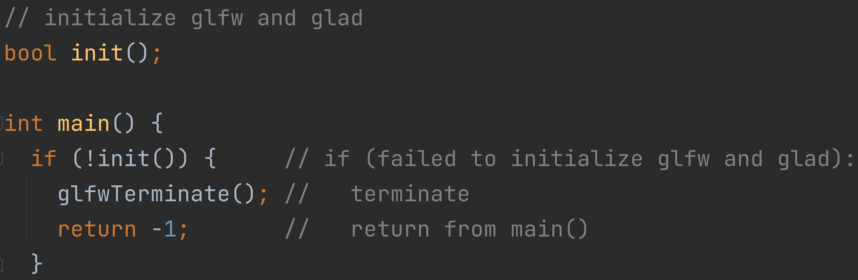
How to create a window?
Initialize glfw and glad

Slide 27
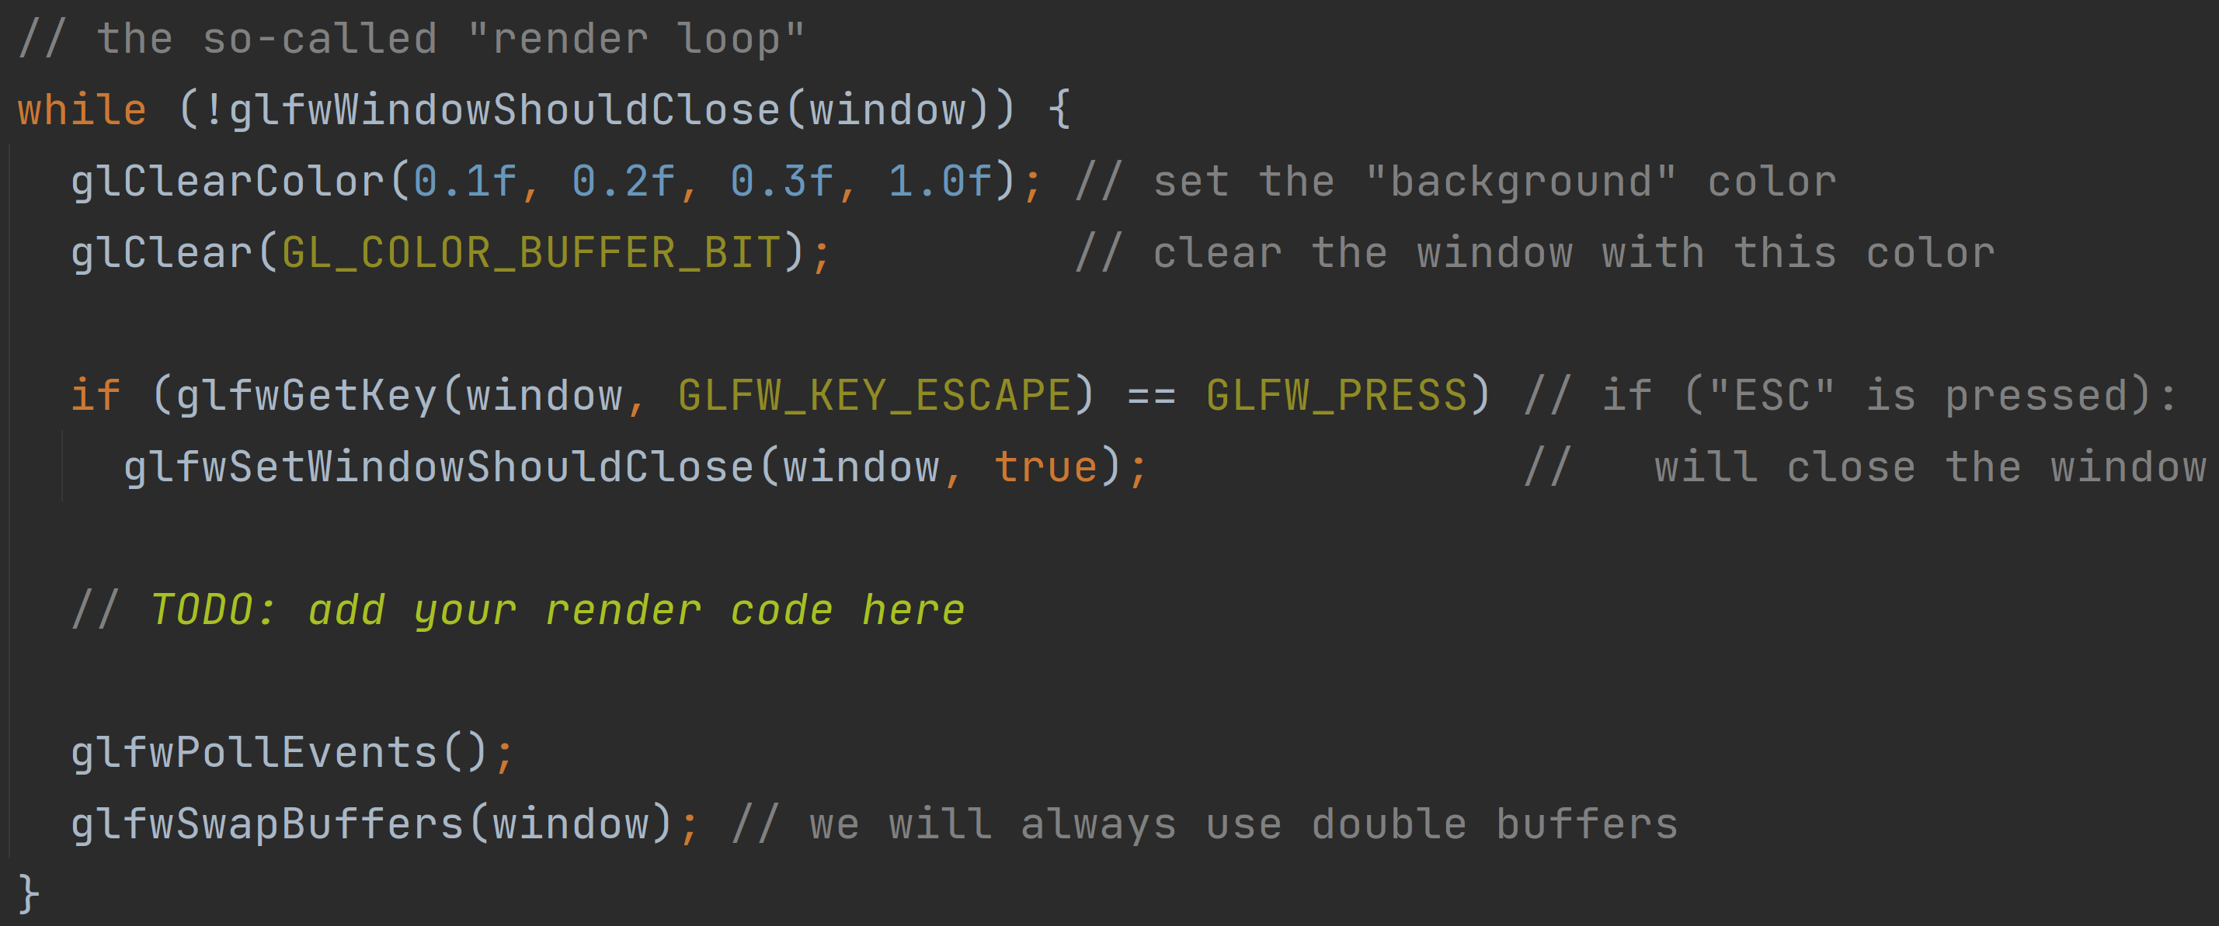
How to create a window?
Initialize glfw and glad
The “render loop”

Slide 28
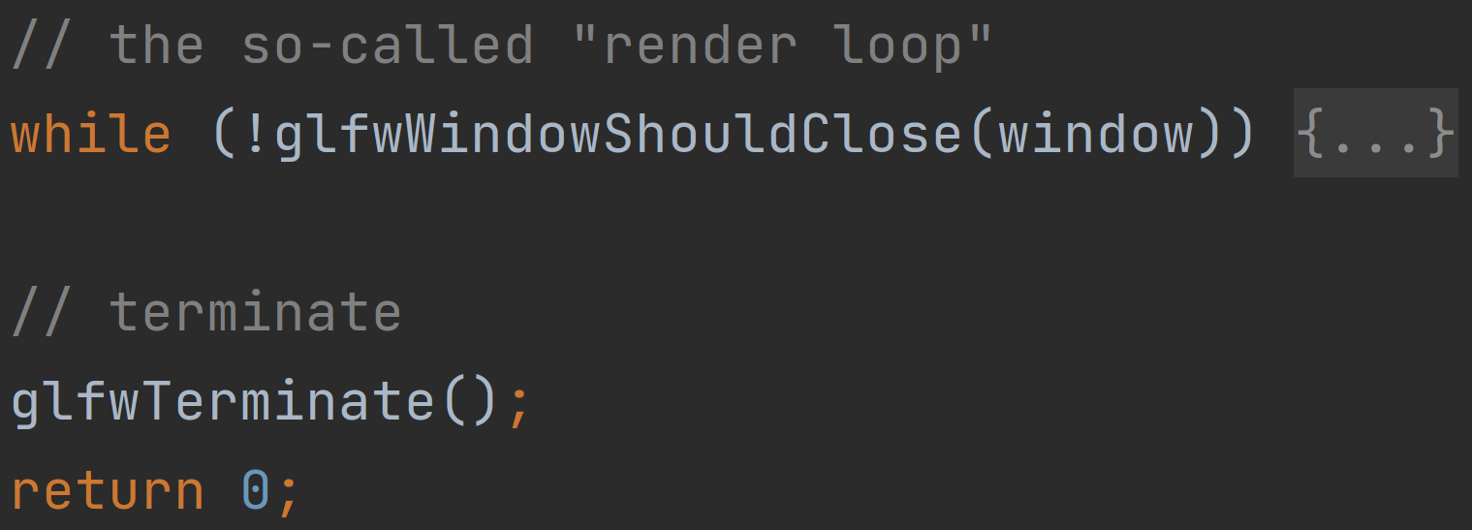
How to create a window?
Initialize glfw and glad
The “render loop”
When “ESC” is pressed

Slide 29
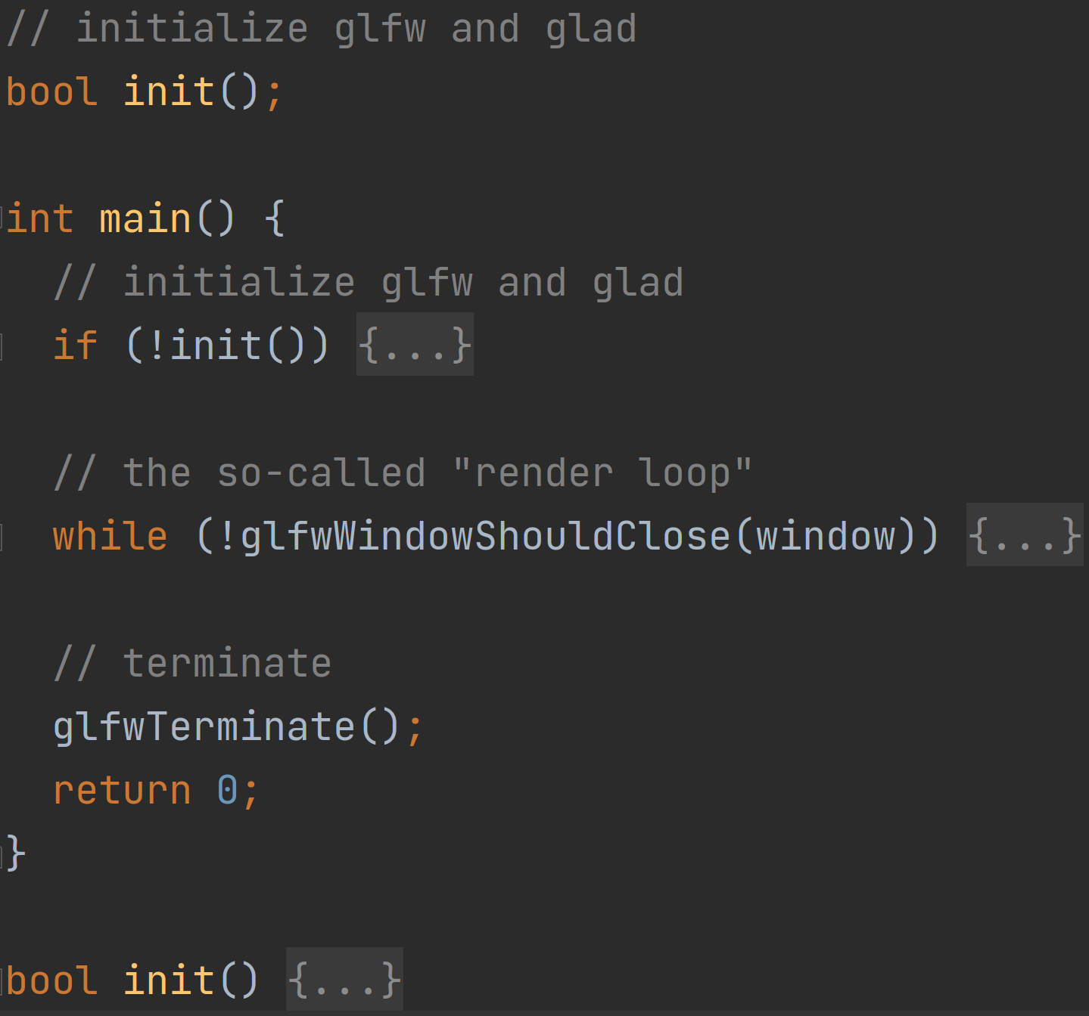
How to create a window?
Initialize glfw and glad
The “render loop”
When “ESC” is pressed
Summary

Slide 30
Outline
CMake
OpenGL, glfw, glad, and glm
How to create a window?
How to draw a triangle?
How to draw a rectangle?
How to draw a colorful rectangle?
How to get time and input?
How to finish HW1?

Slide 31
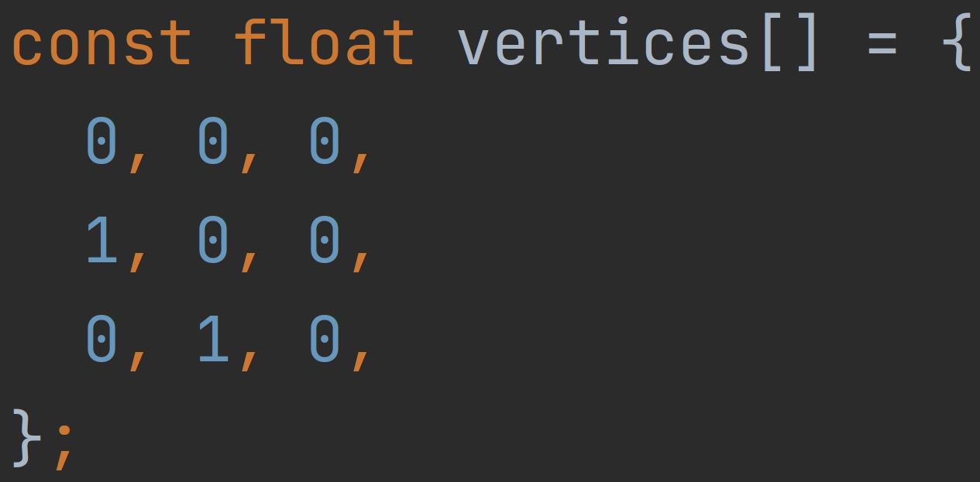
How to draw a triangle?
Vertices

Slide 32
How to draw a triangle?
Vertices
Copy to a GPU buffer

Slide 33
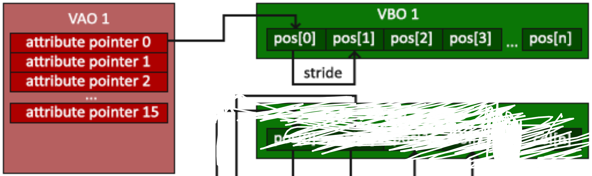
How to draw a triangle?
Vertices
Copy to a GPU buffer
Vertex buffer object (vbo) and vertex array object (vao)

Slide 34
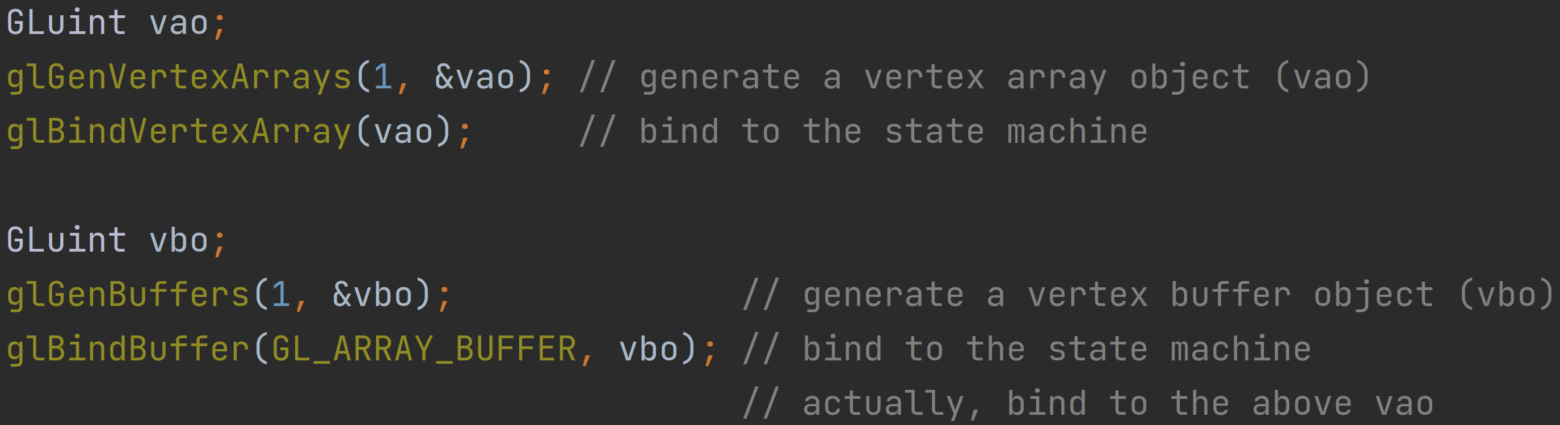
How to draw a triangle?
Vertices
Copy to a GPU buffer
Vertex buffer object (vbo) and vertex array object (vao)

Slide 35
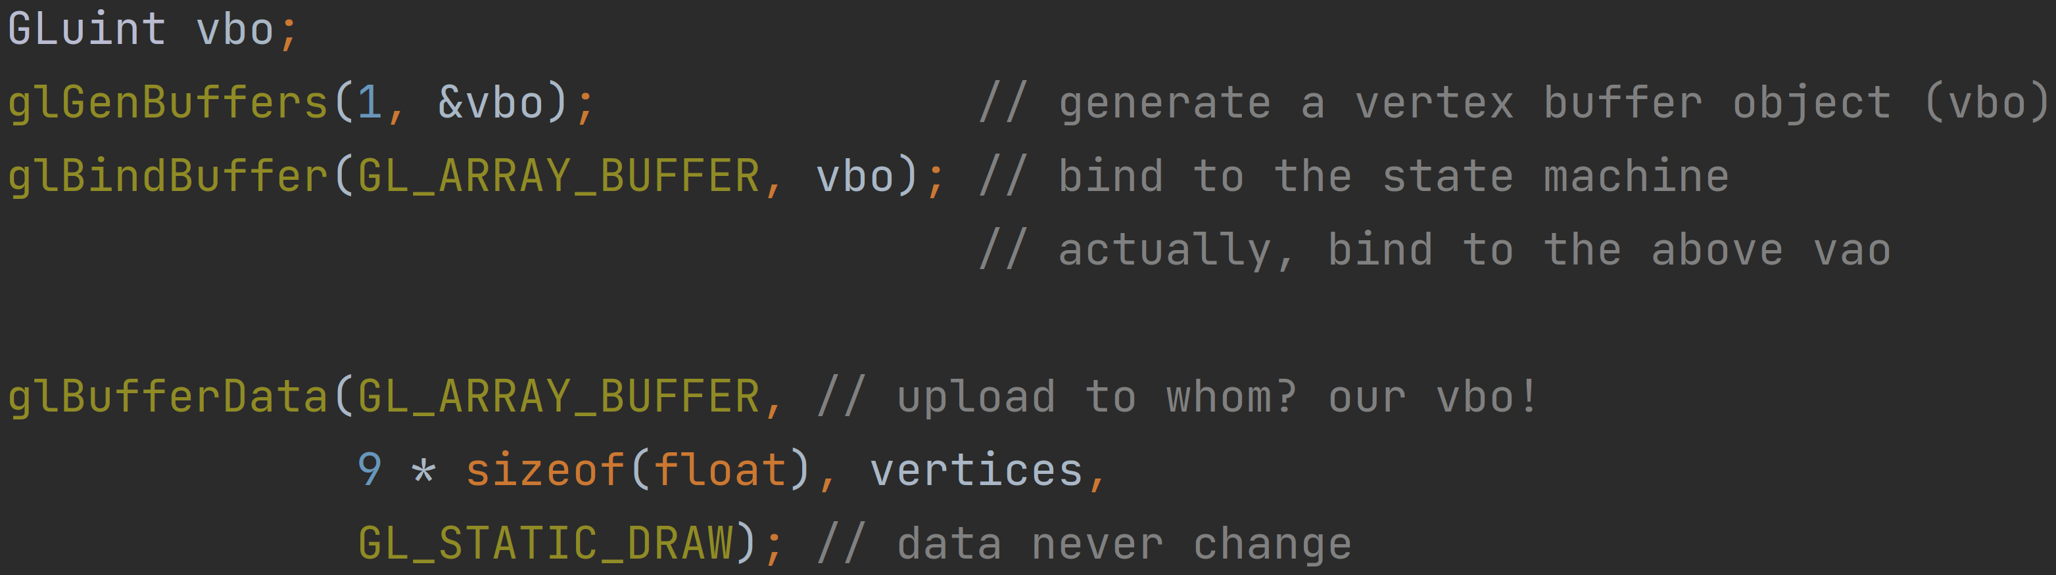
How to draw a triangle?
Vertices
Copy to a GPU buffer
Vertex buffer object (vbo) and vertex array object (vao)
Copy to vbo

Slide 36
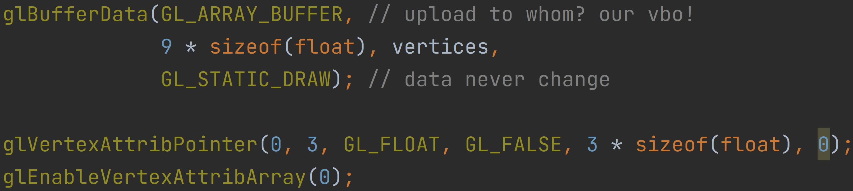
How to draw a triangle?
Vertices
Copy to a GPU buffer
Vertex buffer object (vbo) and vertex array object (vao)
Copy to vbo
Set attribute pointer

Slide 37
How to draw a triangle?
Vertices
Copy to a GPU buffer
Vertex buffer object (vbo) and vertex array object (vao)
Copy to vbo
Set attribute pointer
Unbind the vao

Slide 38
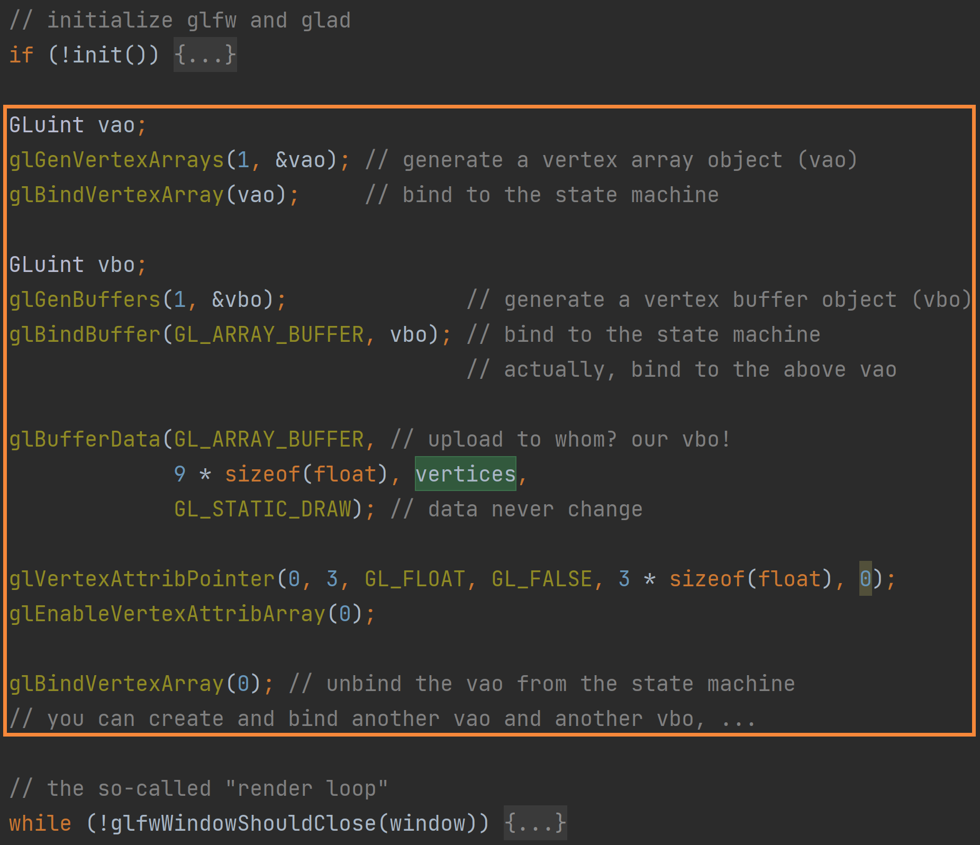
How to draw a triangle?
Vertices
Copy to a GPU buffer
Vao and vbo
Copy to vbo
Set attribute pointer
Unbind the vao
Summary

Slide 39
How to draw a triangle?
Vertices
Copy to a GPU buffer (vao and vbo)
Shader

Slide 40
How to draw a triangle?
Vertices
Copy to a GPU buffer (vao and vbo)
Shader
Tell the GPU how to draw
compiled at runtime

Slide 41
How to draw a triangle?
Vertices
Copy to a GPU buffer (vao and vbo)
Shader
Tell the GPU how to draw
compiled at runtime
Input: position of the 3 vertices of the triangle
Output: color of each pixel (fragment) covered by the triangle

Slide 42
How to draw a triangle?
Vertices
Copy to a GPU buffer (vao and vbo)
Shader
Tell the GPU how to draw
compiled at runtime
Input: vertex data
Output: fragment color

Slide 43
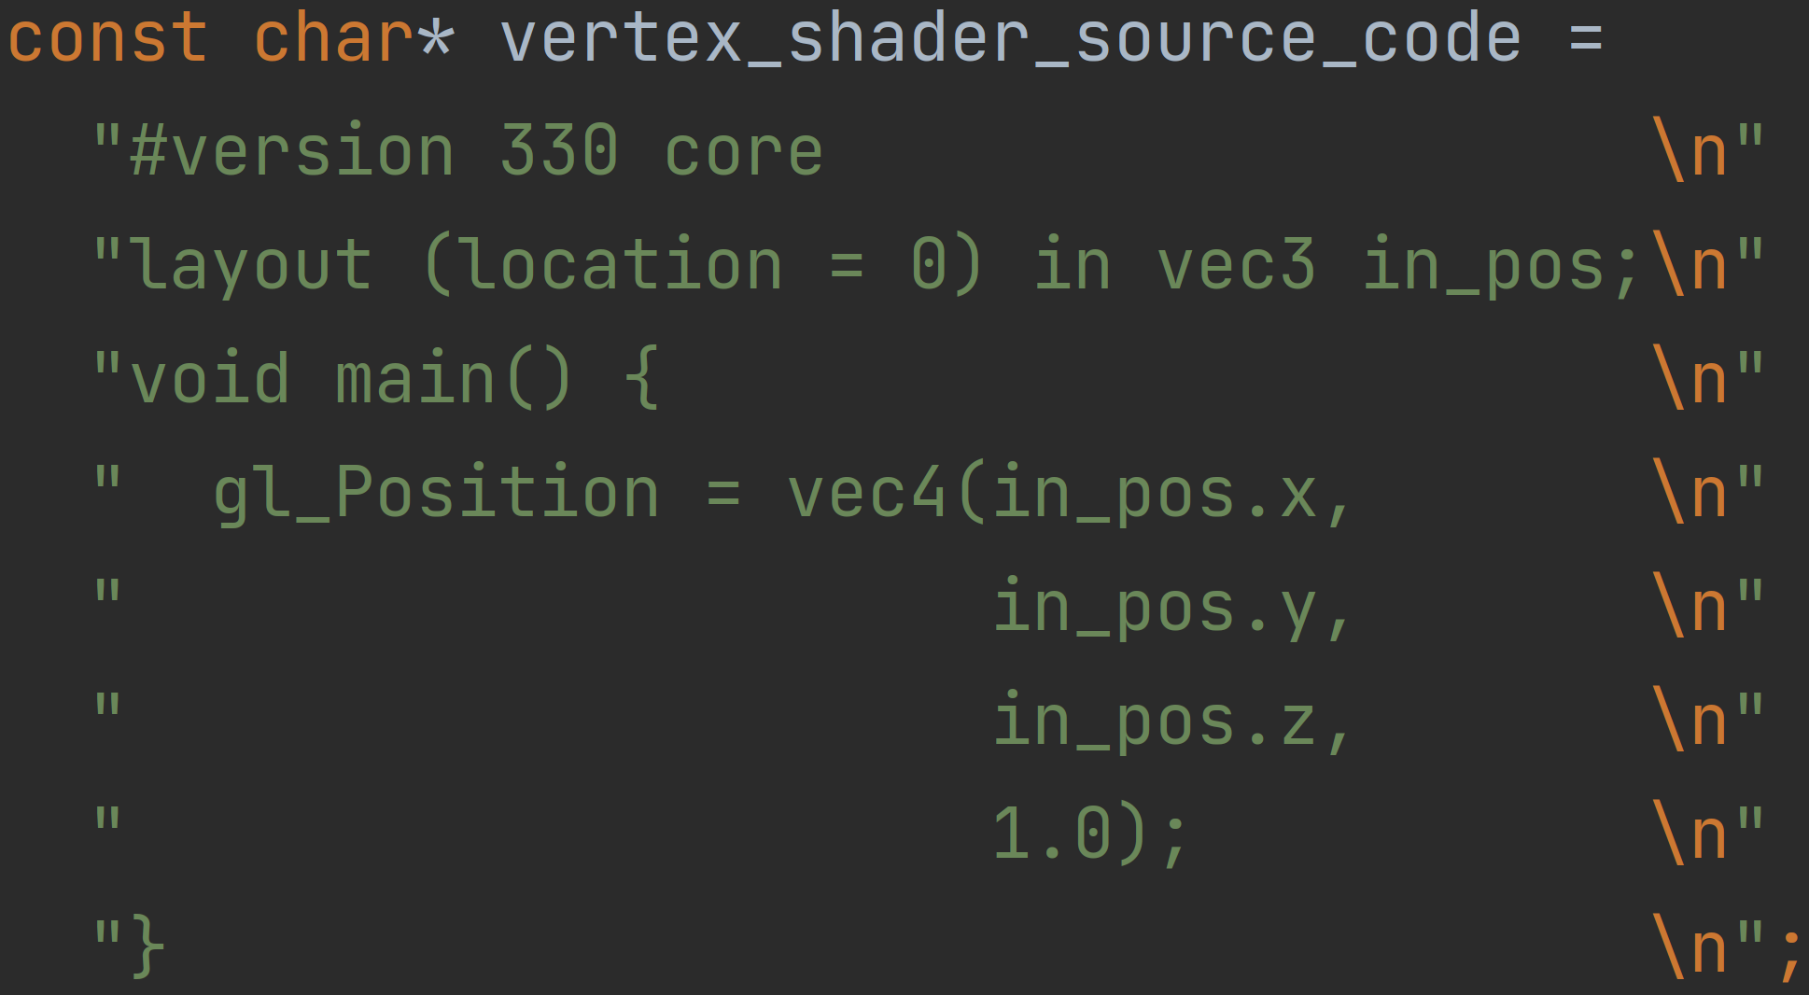
How to draw a triangle?
Vertices
Copy to a GPU buffer (vao and vbo)
Shader
Tell the GPU how to draw
compiled at runtime
Input: vertex data
Output: fragment color
Vertex shader

Slide 44
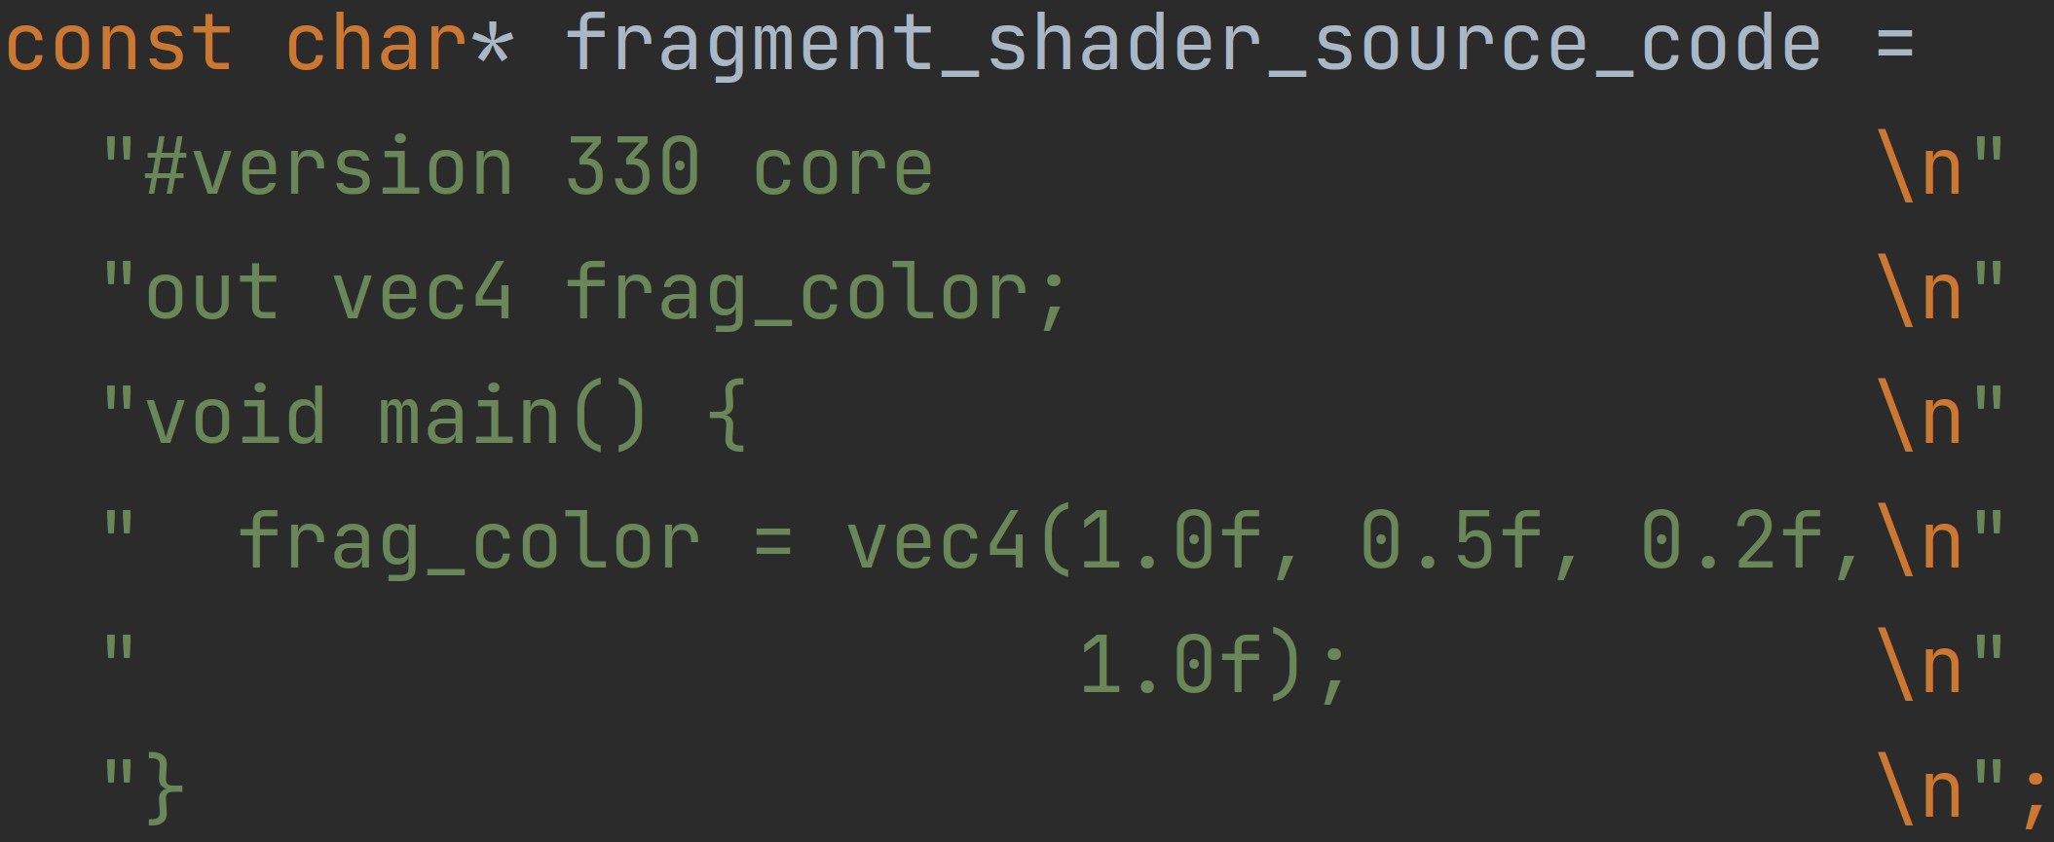
How to draw a triangle?
Vertices
Copy to a GPU buffer (vao and vbo)
Shader
Tell the GPU how to draw
compiled at runtime
Input: vertex data
Output: fragment color
Vertex shader
Fragment shader

Slide 45
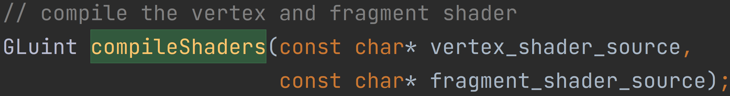
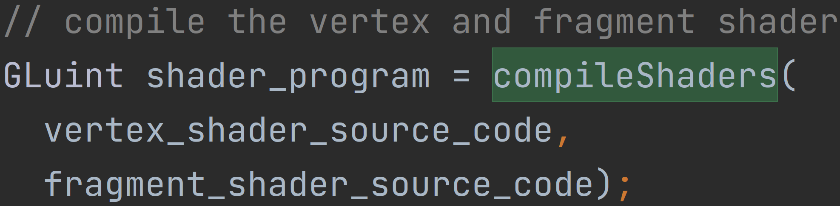
How to draw a triangle?
Vertices
Copy to a GPU buffer (vao and vbo)
Shader
Tell the GPU how to draw
compiled at runtime
Input: vertex data
Output: fragment color
Vertex shader
Fragment shader
Compile them

Slide 46
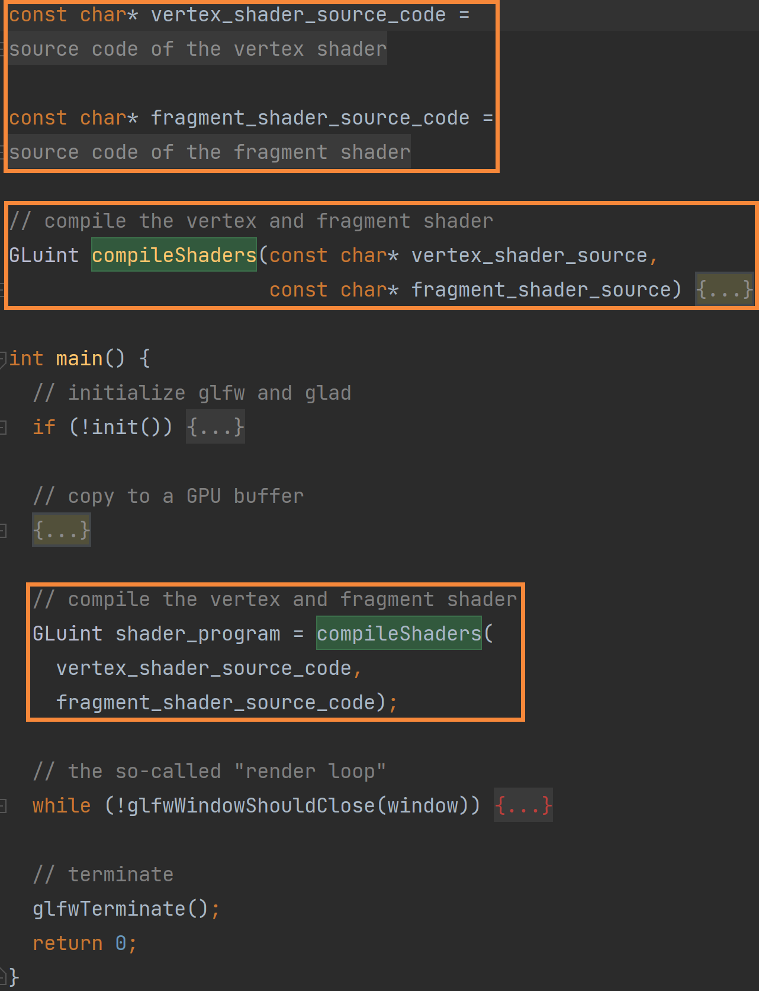
How to draw a triangle?
Vertices
Copy to a GPU buffer (vao and vbo)
Shader
Tell the GPU how to draw
compiled at runtime
Input: vertex data
Output: fragment color
Vertex shader
Fragment shader
Compile them
Summary

Slide 47
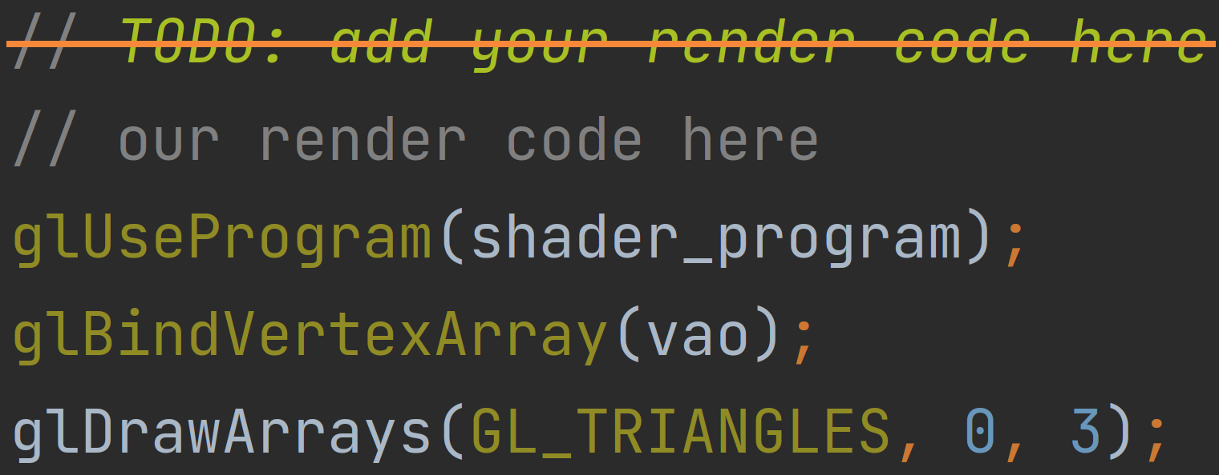
How to draw a triangle?
Vertices
Copy to a GPU buffer (vao and vbo)
Shader
Draw with shader and vao

Slide 48
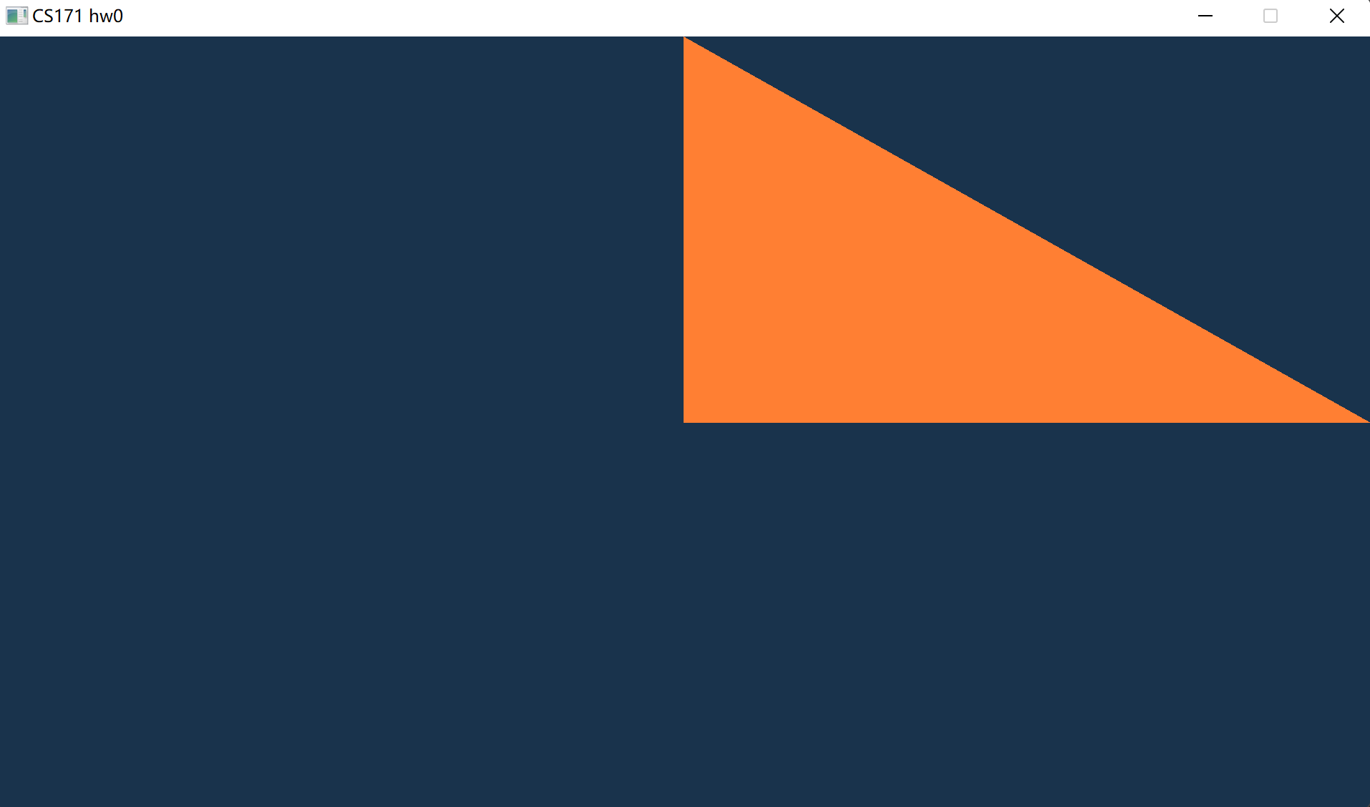
How to draw a triangle?
Vertices
Copy to a GPU buffer (vao and vbo)
Shader
Draw with shader and vao
Compile and run

Slide 49
How to draw a triangle?
Vertices
Copy to a GPU buffer (vao and vbo)
Shader
Draw with shader and vao
Compile and run
why at right-up corner?
why 不是等腰三角形?

Slide 50
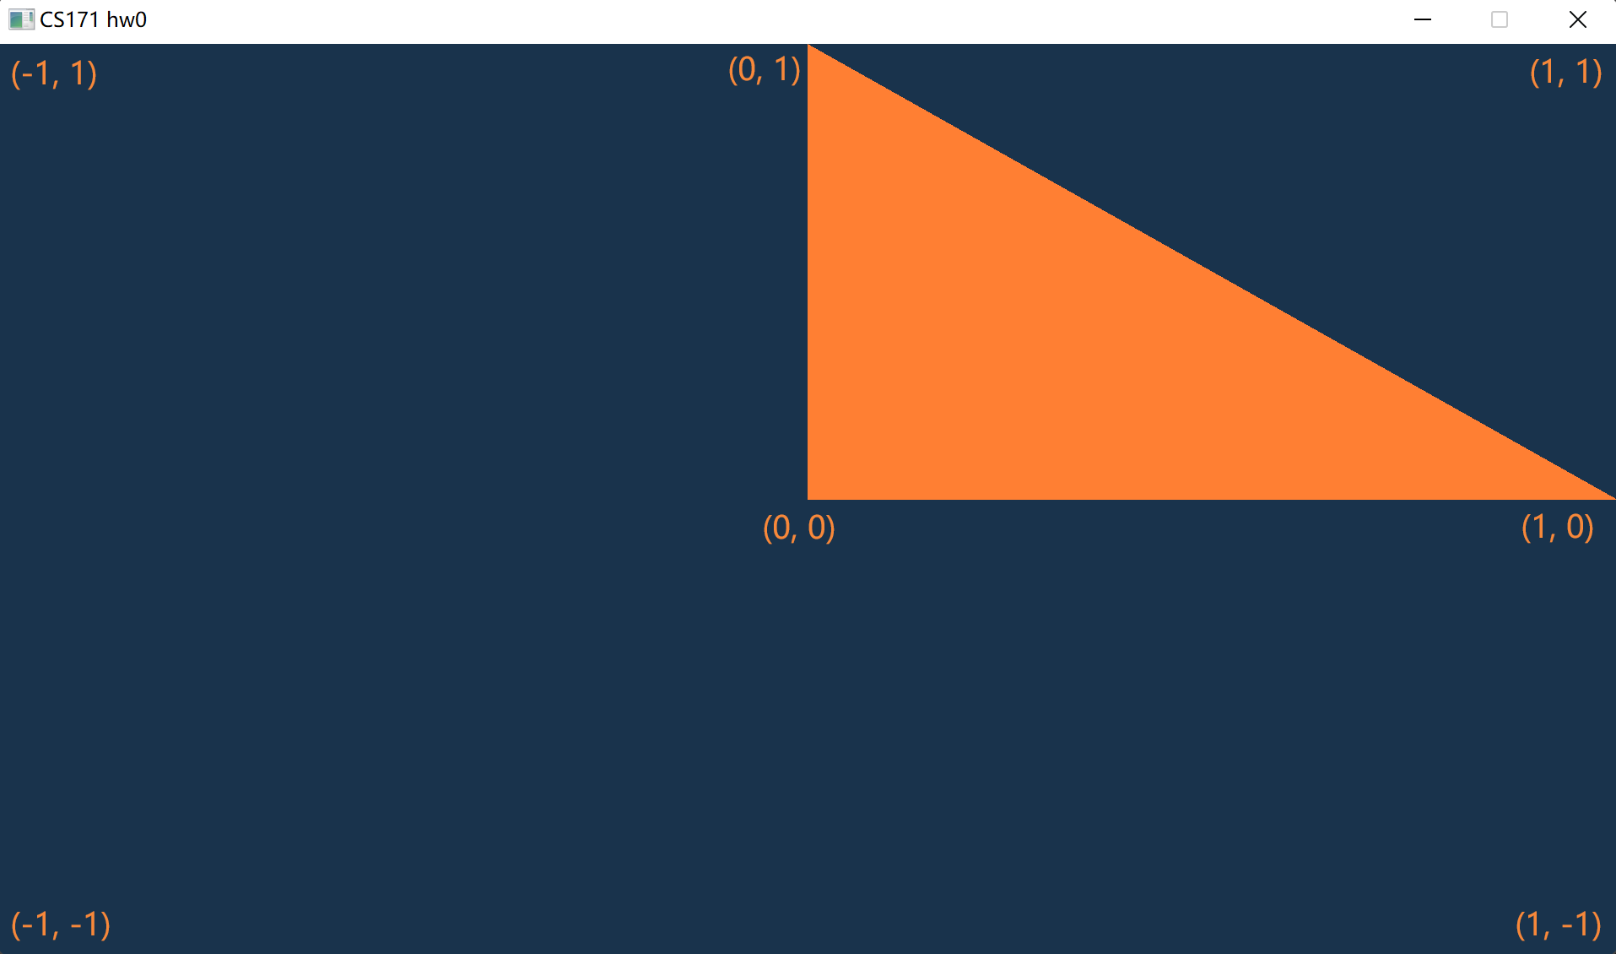
How to draw a triangle?
Vertices
Copy to a GPU buffer (vao and vbo)
Shader
Draw with shader and vao
Compile and run
why at right-up corner?
why 不是等腰三角形?

Slide 51
Outline
CMake
OpenGL, glfw, glad, and glm
How to create a window?
How to draw a triangle?
How to draw a rectangle?
How to draw a colorful rectangle?
How to get time and input?
How to finish HW1?

Slide 52
How to draw a rectangle?
Vertices
Copy to a GPU buffer (vao and vbo)
Shader
Draw with shader and vao
Compile and run

Slide 53
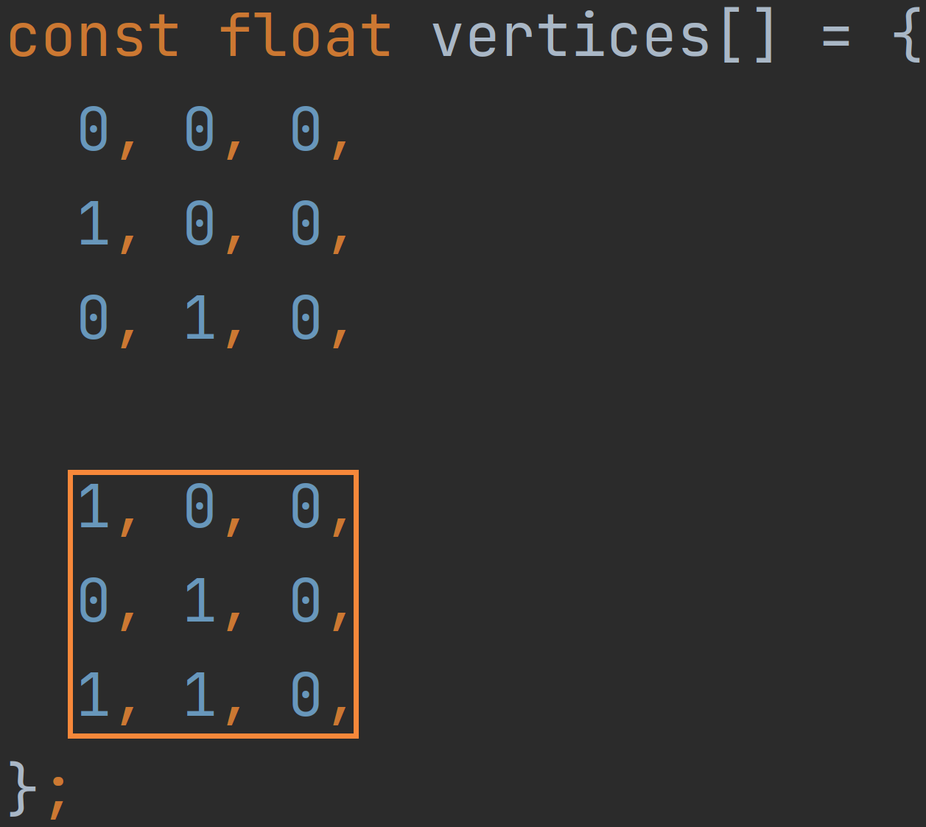
How to draw a rectangle?
Vertices

Slide 54
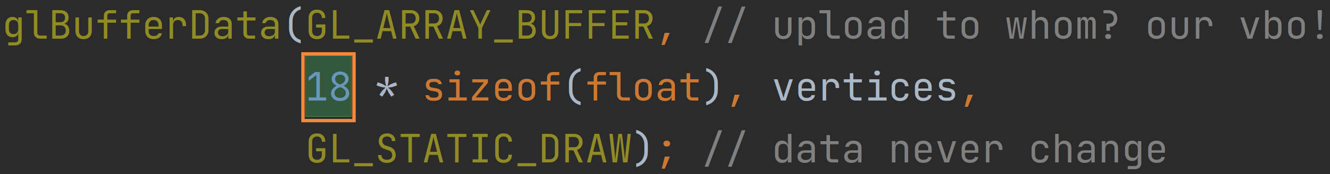
How to draw a rectangle?
Vertices
Copy to a GPU buffer (vao and vbo)

Slide 55
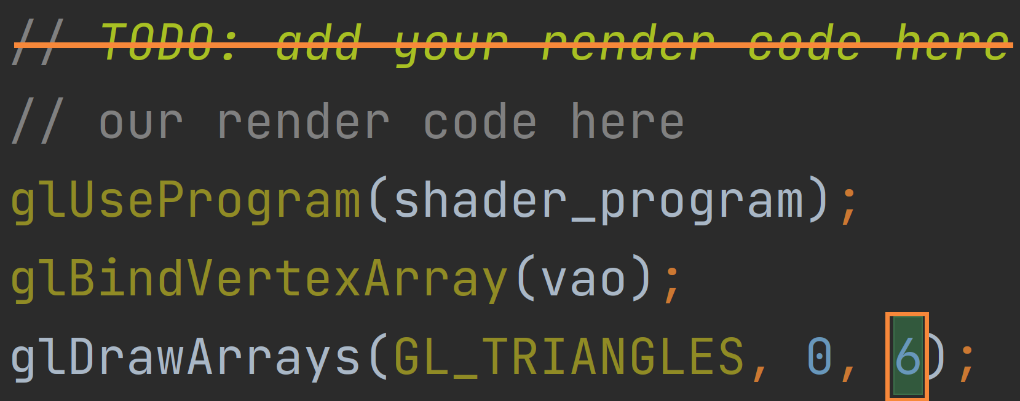
How to draw a rectangle?
Vertices
Copy to a GPU buffer (vao and vbo)
Shader
Draw with shader and vao

Slide 56

How to draw a rectangle?
Vertices
Copy to a GPU buffer (vao and vbo)
Shader
Draw with shader and vao
Compile and run

Slide 57
Outline
CMake
OpenGL, glfw, glad, and glm
How to create a window?
How to draw a triangle?
How to draw a rectangle?
How to draw a colorful rectangle?
How to get time and input?
How to finish HW1?

Slide 58
How to draw a colorful rectangle?
Vertices
Copy to a GPU buffer (vao and vbo)
Shader
Draw with shader and vao
Compile and run

Slide 59
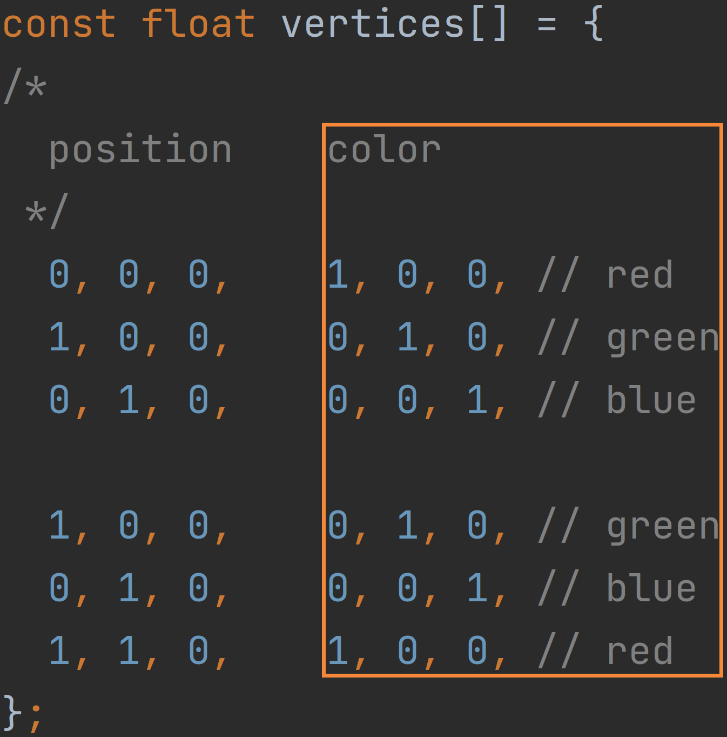
How to draw a colorful rectangle?
Vertices
add color to each vertex

Slide 60
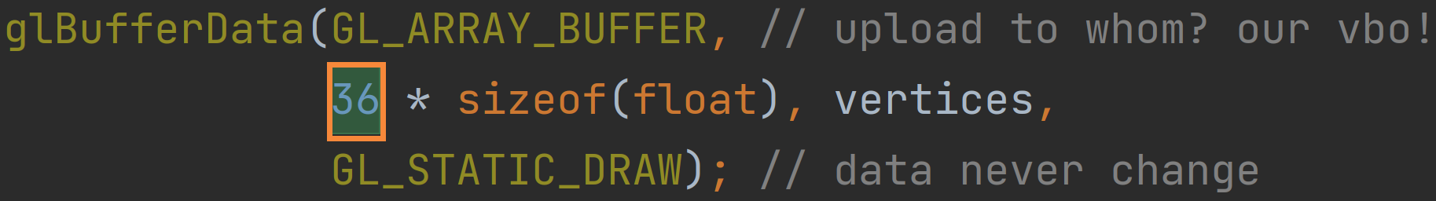
How to draw a colorful rectangle?
Vertices
Copy to a GPU buffer (vao and vbo)
copy more bytes

Slide 61
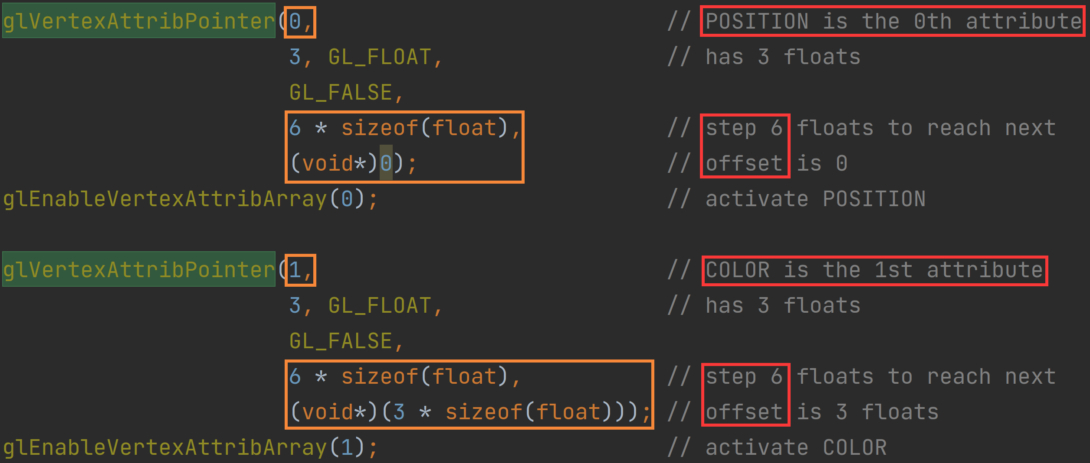
How to draw a colorful rectangle?
Vertices
Copy to a GPU buffer (vao and vbo)
copy more bytes
set another
attribute pointer
for colors

Slide 62
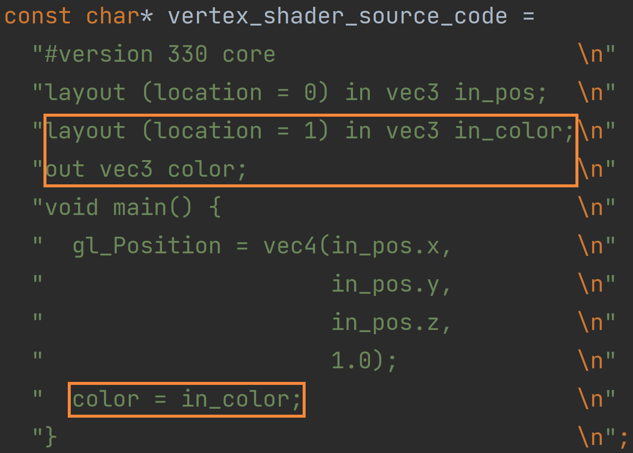
How to draw a colorful rectangle?
Vertices
Copy to a GPU buffer (vao and vbo)
Shader
Vertex shader

Slide 63
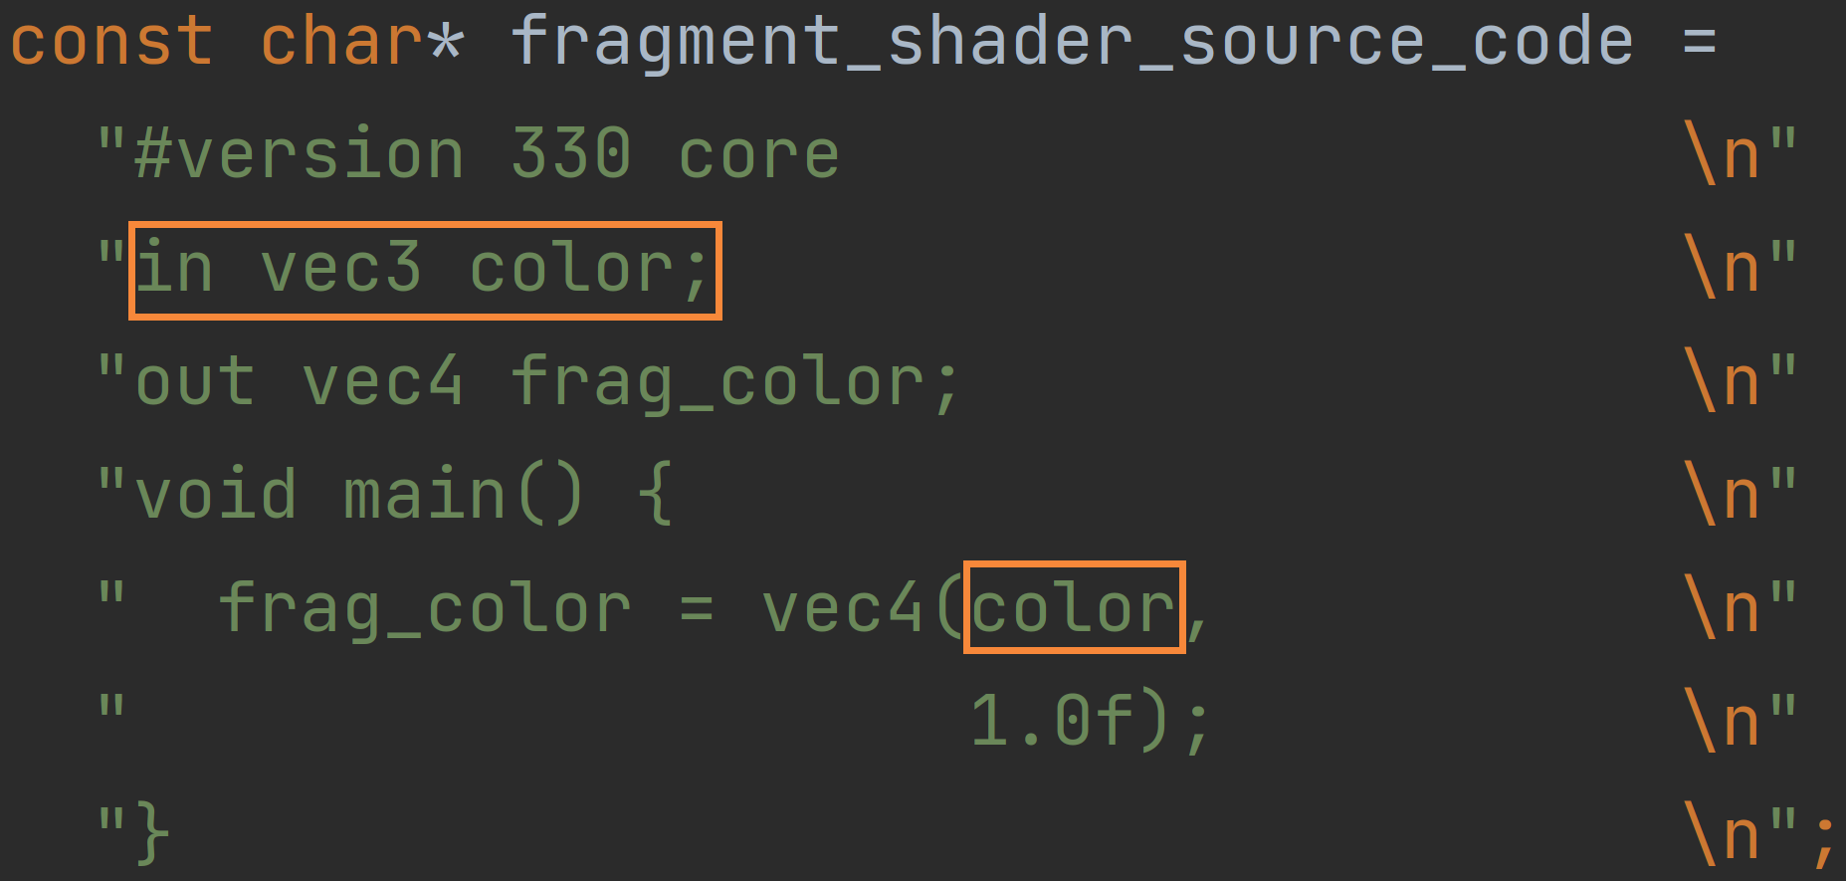
How to draw a colorful rectangle?
Vertices
Copy to a GPU buffer (vao and vbo)
Shader
Vertex shader
Fragment shader

Slide 64
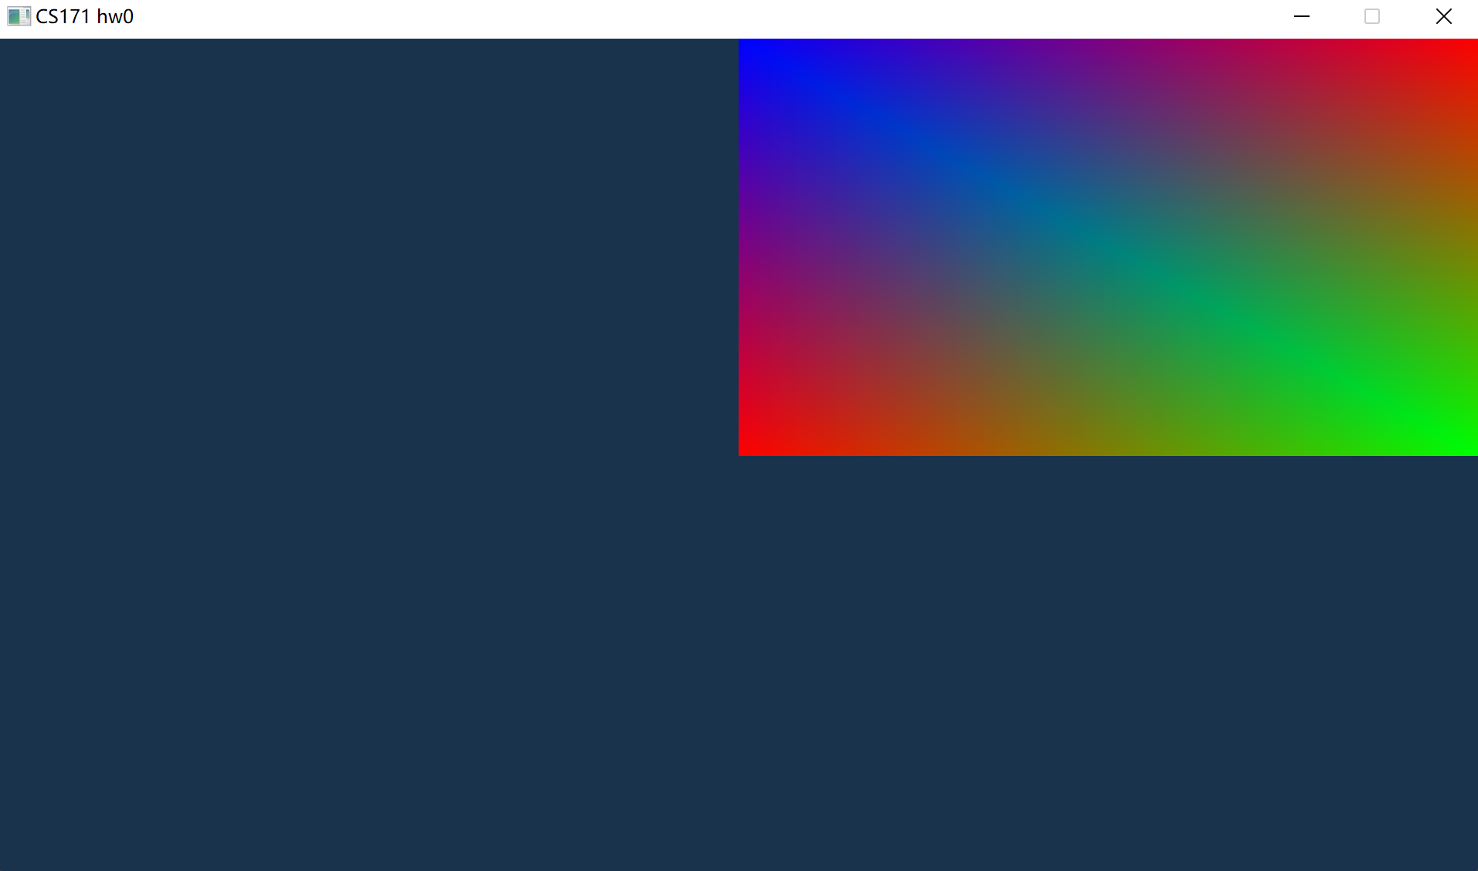
How to draw a colorful rectangle?
Vertices
Copy to a GPU buffer (vao and vbo)
Shader
Draw with shader and vao
Compile and run

Slide 65
Outline
CMake
OpenGL, glfw, glad, and glm
How to create a window?
How to draw a triangle?
How to draw a rectangle?
How to draw a colorful rectangle?
How to get time and input?
How to finish HW1?

Slide 66
How to get time and input?
Time
glfwGetTime()
Input
glfwGetMouseButton()
glfwGetKey()
glfwGetCursorPos()

Slide 67
Outline
CMake
OpenGL, glfw, glad, and glm
How to create a window?
How to draw a triangle?
How to draw a rectangle?
How to draw a colorful rectangle?
How to get time and input?
How to finish HW1?

Slide 68
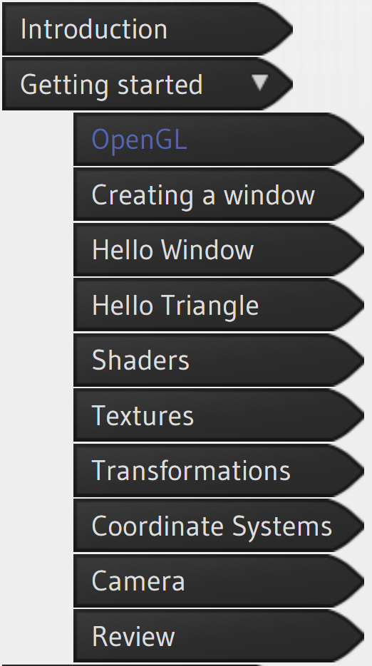
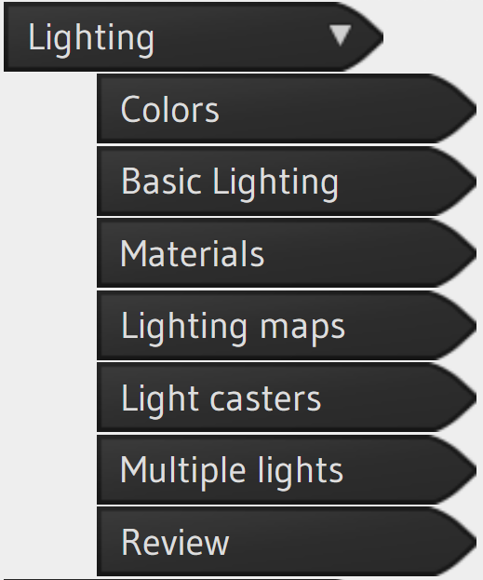
How to finish HW1?
It is impossible to cover every details in tutorials…
Learn more by yourself
LearnOpenGL - OpenGL

Slide 69
How to finish HW1?
It is impossible to cover every details in tutorials…
Learn more by yourself
LearnOpenGL - OpenGL
Write more codes

Slide 70
Thank you

